Slide 1
Azure Container Hackfest Building cloud native applications using Kubernetes

Slide 2
Agenda
Topic | Challenges
Introductory Topics: Cloud native, containers, microservices & Kubernetes Concepts | Challenge #1: Installing Azure Container Service / ACS Engine Challenge #2: Kubernetes Basics Challenge #3: Deploy app end-to-end
ACS Kubernetes Networking | Challenge #4: Service Discovery and Networking Challenge #5: Ingress Controllers Challenge #6: Secrets and ConfigMaps
Deployment Automation, Config Management, CI/CD | Challenge #7: Helm Deployment Challenge #8: CI/CD Challenge #9: Persistent Storage
Infrastructure: Storage, Scaling, Monitoring | Challenge #10: Scaling Challenge #11: Monitoring & Logging Challenge #12: Troubleshooting & Debugging
Advanced Concepts: DaemonSets, StatefulSets, Jobs, InitContainers | Challenge #13: Kubernetes Advanced

Slide 3
Why should customers care about containers and microservices?

Slide 4
In reality, they shouldn’t…

Slide 5
They do care about cloud native applications
“Unlimited” Scale
Global reach
Rapid innovation -> time to market
Notes:
IE – We don’t build cloud native, distributed apps just because it is “cool” and new. The business benefits are key

Slide 6
“Distributed apps are sufficiently complicated that they need to be flown by the instruments”
Notes:
This is meant to highlight the need for advanced tooling and orchestration for highly complex distributed apps

Slide 7
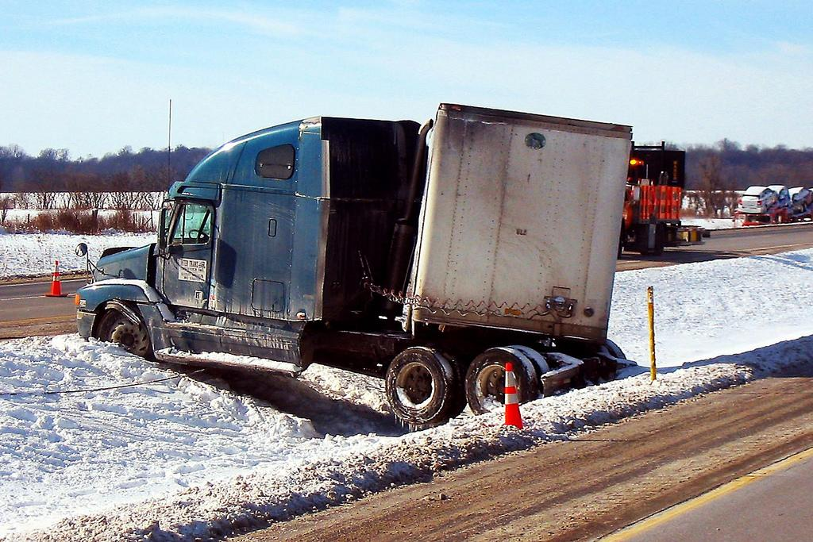

Notes:
Optional instead of prior slide

Slide 8
Microservices

Slide 9
microservices ≠ containers
microservices is an architectural design approach
containers are an implementation detail that often helps

Slide 10
Microservices Benefits
Independent deployments
Enables continuous delivery
No downtime upgrades
Improved scale and resource utilization per service
Fault isolation
Security isolation
Services can be distributed across multiple servers or environments
Multiple languages / diversity
Smaller, focused teams
Code can be organized around business capabilities
Autonomous developer teams

Slide 11
Microservices – The Hard Part
Deployment is complex
Testing is difficult
Debugging is difficult
Monitoring/Logging is difficult
New service versions must support old/new API contracts
Distributed databases make transactions hard
Cluster and orchestration tools overhead
Distributed services adds more network communication
Increased network hops
Requires failure/recovery code
Need service discovery solution
Advanced DevOps capability: short-term pain for long-term gain

Slide 12
12-Factor Apps
http://12factor.net
Notes:
Explain the benefits of 12 factor apps without walking through all of them.
Recommended guidelines for good microservices apps

Slide 13
12-Factor Apps (1-5)
Single root repo; don’t share code with another app
Deploy dependent libs with app
No config in code; read from environment vars
Handle unresponsive app dependencies robustly
Strictly separate build, release, & run steps
Build: Builds a version of the code repo & gathers dependencies
Release: Combines build with config ReleaseId (immutable)
Run: Runs app in execution environment
Notes:
Single root repo; don’t share code with another app
Deploy dependent libs with app
No config in code; read from environment vars
Handle unresponsive app dependencies robustly
Strictly separate build, release, & run steps
Build: Builds a version of the code repo & gathers dependencies
Release: Combines build with config → ReleaseId (immutable)
Run: Runs app in execution environment

Slide 14
12-Factor Apps (6-12)
App executes as 1+ stateless process & shares nothing
App listens on ports; avoid using (web) host
Use processes for isolation; multiple for concurrency
Processes can crash/be killed quickly & start fast
Keep dev, staging, & prod environments similar
Log to stdout (dev=console; prod=file & archived)
Deploy & run admin tasks (scripts) as processes
Notes:
App executes as 1+ stateless process & shares nothing
App listens on ports; avoid using (web) host
Use processes for isolation; multiple for concurrency
Processes can crash/be killed quickly & start fast
Keep dev, staging, & prod environments similar
Log to stdout (dev=console; prod=file & archived)
Deploy & run admin tasks (scripts) as processes

Slide 15
From traditional app to modern app
APP
Existing Application
Modern Infrastructure
Move to the cloud as VMs or Containers or refresh HW.
Modern Methodologies
Implement CI/CD and automation.
Containerize Applications
Re-architect apps for scale with containers.
Modern Microservices
Add new services or start peeling off services from monolithic code.

Slide 16
What we hear from developers
I need to create applications at a competitive rate without worrying about IT
New applications run smoothly on my machine but malfunction on traditional IT servers
My productivity and application innovation become suspended when I have to wait on IT

Slide 17
What we hear from IT
I need to manage servers and maintain compliance with little disruption
I’m unsure of how to integrate unfamiliar applications, and I require help from developers
I’m unable to focus on both server protection and application compliance

Slide 18
What is a container?
Containers = operating system virtualization
Traditional virtual machines = hardware virtualization
OS
Application
VM
VM
VM
Applications
Container
Container
Container
App
App
App
Kernel
OS
OS
OS
OS
Hardware
Hardware

Slide 19
Virtualization versus containerization
Virtual machine
Container
Application XYZ
Application
App dependencies
Dependencies
Guest OS
C
C
C
C
C
VM
VM
VM
VM
VM
VM
Dependency 1
Dependency 2
Hypervisor 2
Docker Engine
Hypervisor 1
Host OS
Host OS
Hardware
Hardware
Hardware
Type 1
Type 2
Virtualization
Containerization

Slide 20
The container advantage
Traditional virtualized environment
VM
VM
Low utilization of container resources
Application
Con.
Con.
Application
Containerization of applications and their dependencies
Con.
Con.
Hypervisor 2
Host OS
Hardware

Slide 21
The container advantage
Containerized environment
Migrate containers and their dependencies to underutilized VMs for improved density and isolation
VM
VM
Con.
Con.
Decommission unused resources for efficiency gains and cost savings
Con.
Con.
Docker Engine
Host OS
Hardware

Slide 22
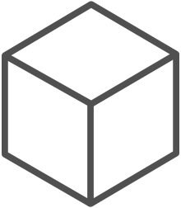
The container advantage
Fast iteration
Agile delivery
Immutability
Cost savings
Efficient deployment
Elastic bursting
For developers
For IT

Slide 23


Containers are gaining momentum
Does your organization currently use container technologies?¹
23%
My org. is evaluating container technologies
Yes, my org. currently uses container technologies
No, my org. is not using container technologies
Not sure
Not applicable
Larger companies are leading adoption.²
42%
~60%
25%
7%
Nearly 60% percent of organizations running 500 or more hosts are classiﬁed as container dabblers or adopters.
2%
The average company QUINTUPLES its container usage within 9 months.¹
Container hosts often run SEVEN containers at a time.¹
Containers churn 9 times FASTER than VMs.¹
5x
7x
9x
Source:
1: Datadog: 8 Surprising Facts About Real Docker Adoption; 2: DZone: The DZone Guide to Deploying and Orchestrating Containers

Slide 24
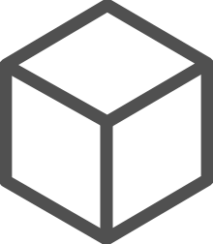
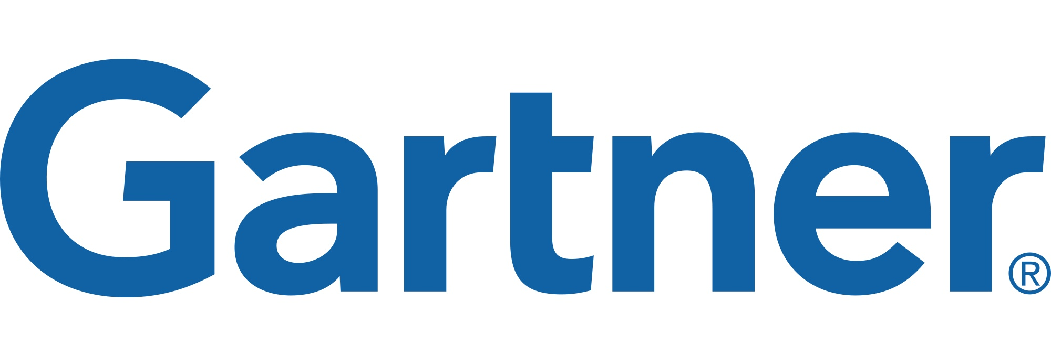
Industry analysts agree
“By 2020, more than 50% of enterprises will run mission-critical, containerized cloud-native applications in production, up from less than 5% today.”

Slide 25
Containers are great, right??

Slide 26
Docker, Docker, Docker
Containers have been around for many years
Linux kernel: cgroups, namespaces
Docker Inc. did not invent them
They created open source software to build and manage containers
Docker makes containers easy
Super easy. Fast learning curve
Docker is a container format and a set of tools
Docker CLI, Docker Engine, Docker Swarm, Docker Compose, Docker Machine
Notes:
Can skip the container slides based on audience level

Slide 27
What is a container?
Slice up the OS to run multiple apps on a single VM
Every container has an isolated view and gets
it’s own file system
it’s own PID0 and eth0 network interface
Container and apps share lifecycle
Shared kernel, very fast start-up, and repeatable execution
Cannot mix OS
VM/Host
Container: App-A:v1
Container: App-B:v3
Container: App-A:v2
App-A v1
App-B v3
App-A v2
Lib-L v2
Lib-L v3
Lib-L v3
Lib-M v2
Runtime v5
Runtime v7
Runtime v6

Slide 28

Why containers?
Repeatable execution
immutable environment
reusable and portable code (“Build, Ship, and Run”)
Consistency across development, test, & production
Fast & agile app deployment; instant startup
Cloud portability
Density, partitioning, scale
Diverse developer framework support
Promotes microservices

Slide 29

Containers deliver speed, flexibility, and savings
Availability
Hyper-scale
Agility
62%
Report reduction in MTTR
41%
Move workloads across private/public clouds
13X
More software releases
10X
Cost reduction in maintaining existing applications
65%
Reduction in developer onboarding time
Eliminate
“works on my machine” issues
State of App development Survey: Q1 2016, Cornell University case study

Slide 30
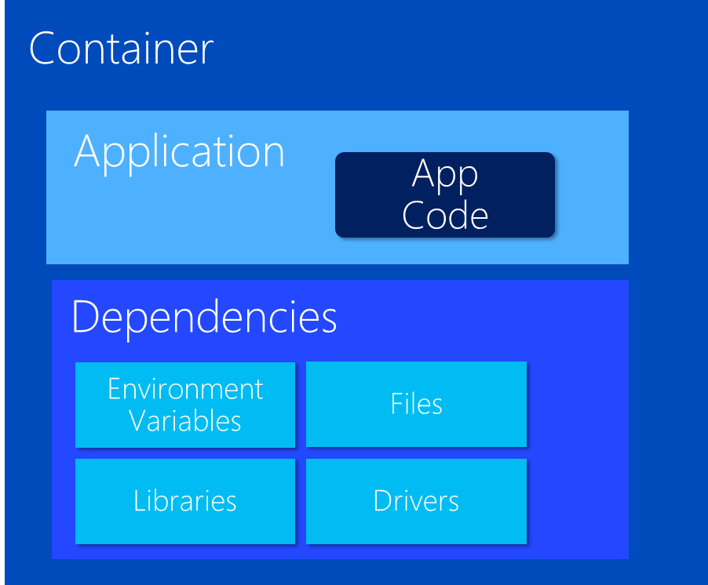
VM Host
VM Host
VM Host
VM Host
Things get
complicated quickly…

Slide 31
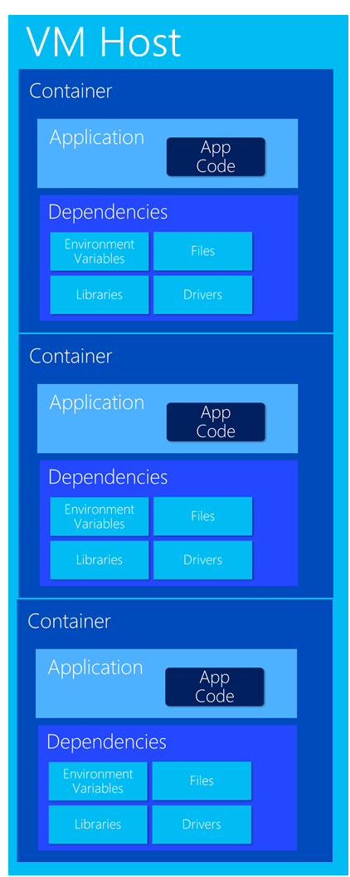
Very Quickly

Slide 32
Container Management at Scale
Cluster Management: deploy and manage cluster resources
Scheduling: where containers run
Lifecycle & Health: keep containers running despite failure
Service Discovery & Load Balancing: where are my containers and how to connect
Security: control access to cluster resources and protect secrets
Scaling: make sets of containers elastic in number
Image repository: centralized, secure Docker container images
Continuous Delivery: CI/CD pipeline and workflow
Logging & Monitoring: track what’s happening in containers and cluster
Storage volumes: persistent data for containers
Notes:
“Container-centric infrastructure”
Additionally: configuration management, debugging/introspection, identity and authorization

Slide 33


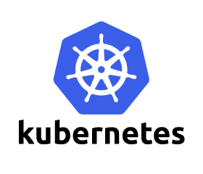


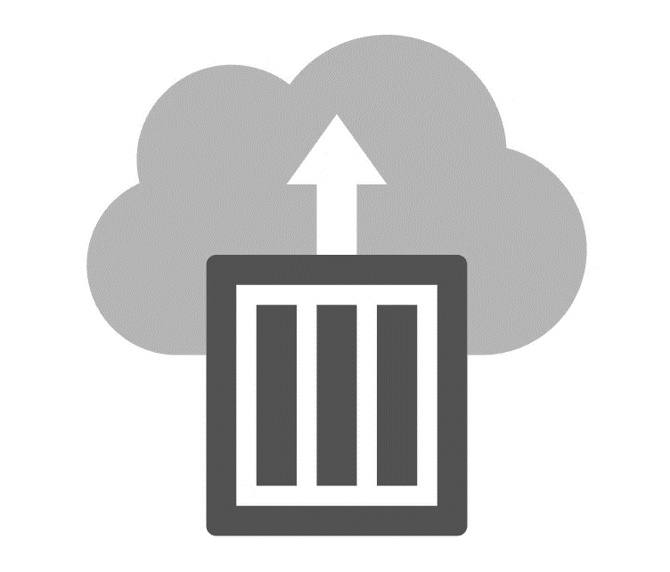
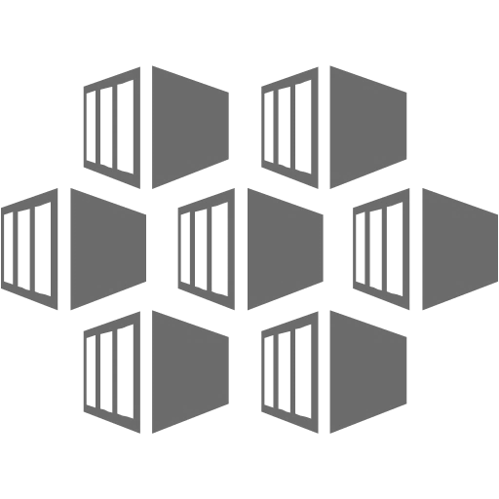
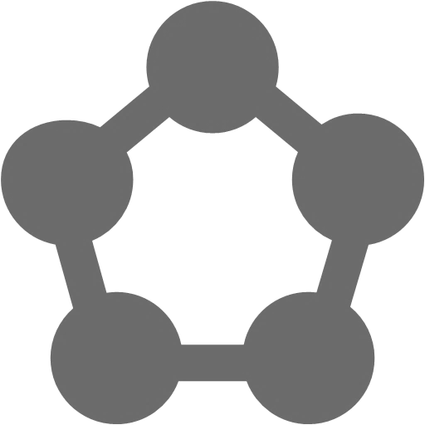


Azure Container Support
Pivotal
Cloud Foundry
Mesos DC/OS
Azure Container Instance
Azure Container Service (AKS)
Service Fabric
Web Apps
Batch
Notes:
Can you this slide or slide 25 here

Slide 34



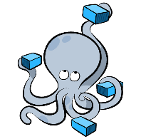
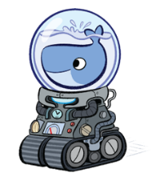













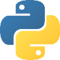







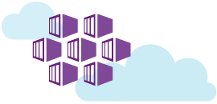
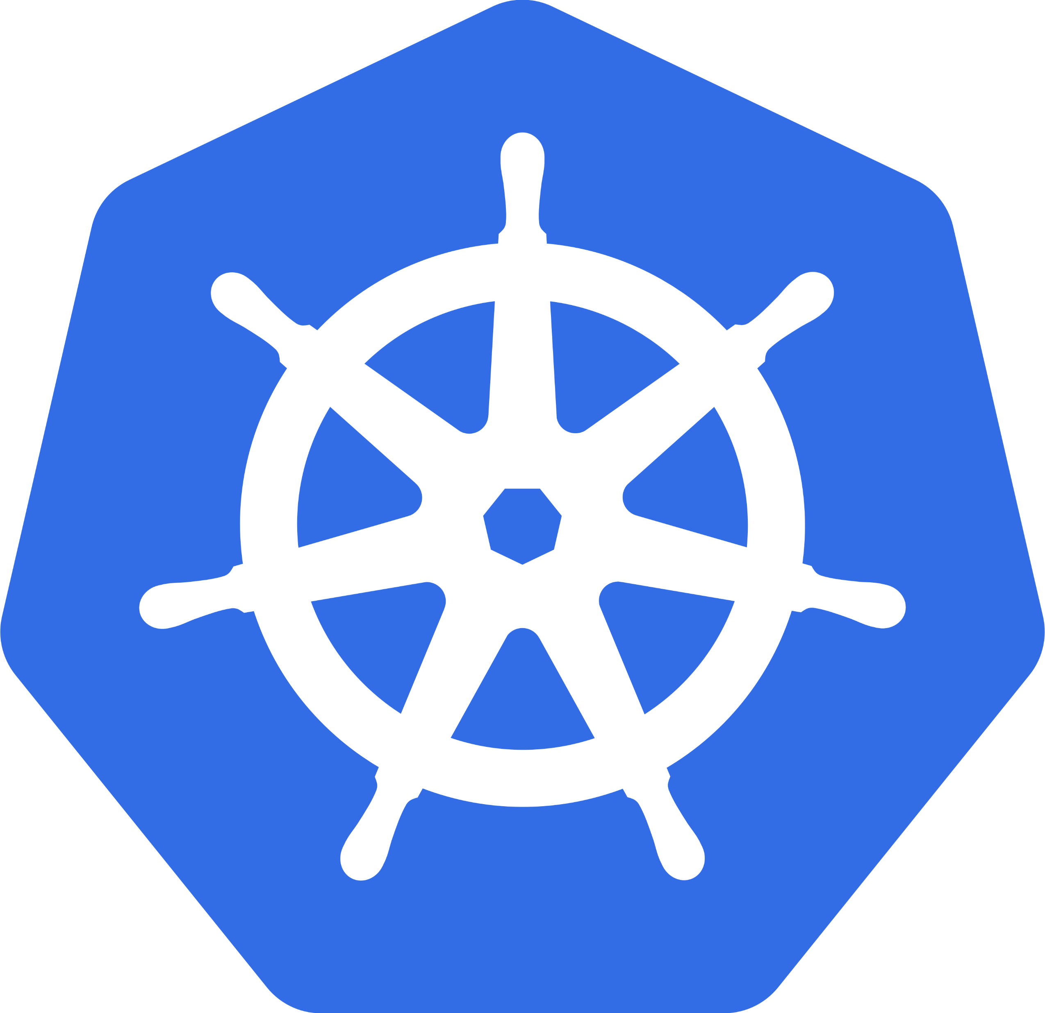










Azure Open Source Container Portfolio
Developer & Data Agility with Containers in the Cloud
Developers
Operations
Data scientists
OMS
Docker VM Extension for Azure
Open source container-based PaaS platforms in Azure
Azure Container Service (AKS)
Azure Marketplace container partners
Easy and programmatic way to add Docker capabilities to your VMs
Container-ready application platforms that benefit from Azure’s native partitioning, capacity management and high availability
Optimized container hosting in the cloud with familiar tooling and your choice of orchestrator
Partner solutions that address management challenges of containers
Pivotal Cloud Foundry
Microsoft Azure
Workload portability
Cross-cloud orchestration
Tools integration
Windows Server
Linux
Azure Stack
Your own platform
Notes:
Can this slide instead of slide 24

Slide 35
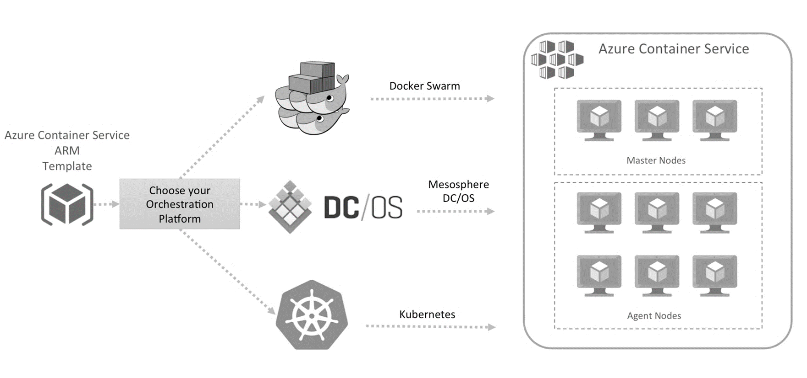
Azure Container Service (today)

Slide 36


Azure Container Service (today)
Managed delivery of optimized container hosting solution
Orchestrate container applications using popular open source tooling
Choose your orchestrator:
Kubernetes
Docker
Mesosphere DC/OS
Migrate container workloads to and from Azure
Full support from Microsoft / Docker / Mesosphere
Leverage Azure Platform capabilities
VM Scale Sets
Networking
Security

Slide 37
Azure Container Service (AKS) Simplify the deployment, management, and operations of Kubernetes
Container hosting solution optimized for Azure
Azure-hosted control plane
Only pay for resource consumption
Automated upgrades, self-healing, easy scaling
Ease Kubernetes management with open source upstream portability
Deploy alternative orchestrators (Docker, Mesos DC/OS)
Notes:
AKS IS NOT “Azure Kubernetes Service”
Reference the history in ACS
Becoming a Kubernetes centric service. Docker and Mesos will eventually be more Azure Marketplace offerings

Slide 38
AKS Overview
Fully managed Kubernetes control plane:
No VMs to operate
No patching required
Provisioned in under 2 minutes
SLA-available service (99.95%)
Transparently scales with cluster size:
1, 50, 100, 250, 500, etc.
Upstream Kubernetes
Free (no charge for control plane)

Slide 39
AKS Features
Automated Kubernetes upgrades
Self-healing Control Plane
etcd SSD backed, automated, H/A, backup/restore
Customized networking (Azure VNETs, CNI)
Cluster scaling
TLS everywhere. Backed by Azure KeyVault
RBAC and Azure AD integrated
Hybrid Clusters (futures)
Notes:
Some features are not available in preview

Slide 40
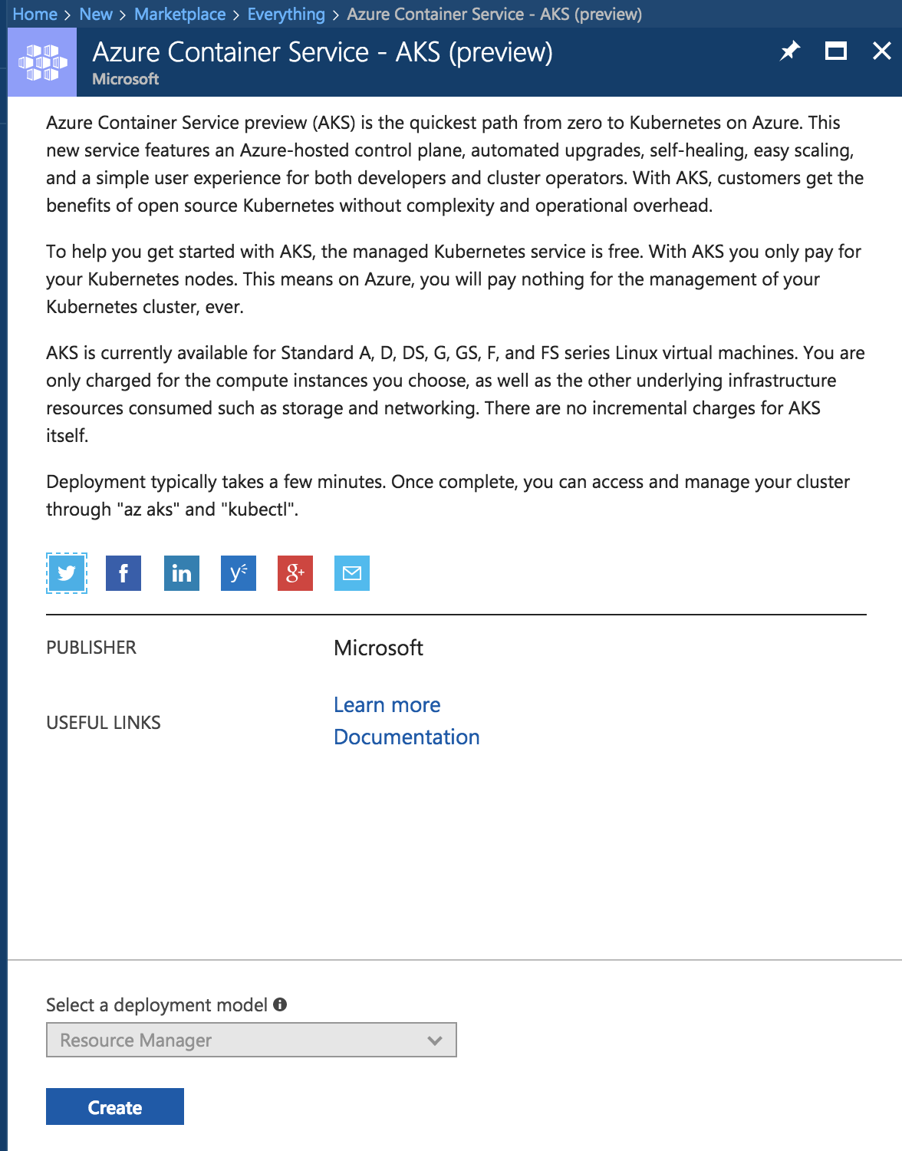
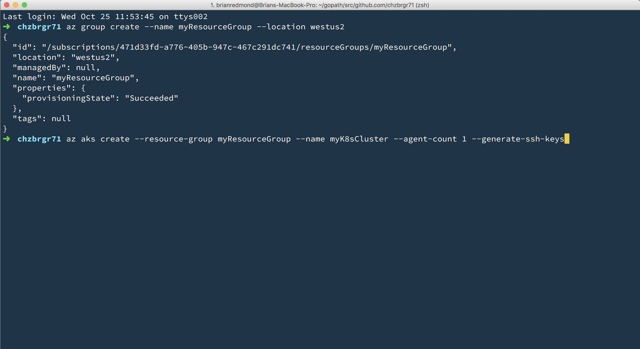
Deploy using Portal, CLI/Cloud Shell, or ARM

Slide 41
ACS Engine – Fully customized deployments
Generates ARM templates for Azure Container Service clusters
Golang tool - can be run in Docker or natively on Windows, OS X, Linux
Cluster defined by a JSON cluster definition file
Generates ARM template or directly deploys to Azure
Some of the customization options:
Choice of DC/OS, Kubernetes, or Swarm orchestrators
Multiple agent pools where each agent pool can specify:
standard or premium VM Sizes
node count
Virtual Machine ScaleSets or Availability Sets
Storage Account Disks or Managed Disks (under private preview)
Docker cluster sizes of 1200
Custom VNET

Slide 42
Azure Container Instance (ACI) Containers as a core Azure resource
Fastest and easiest way to run a container in the cloud
No VM management
Per-second billing based on resource requirements (CPU + Memory)
Deploy images from DockerHub, Azure Container Registry, or any other Docker registry

Slide 43

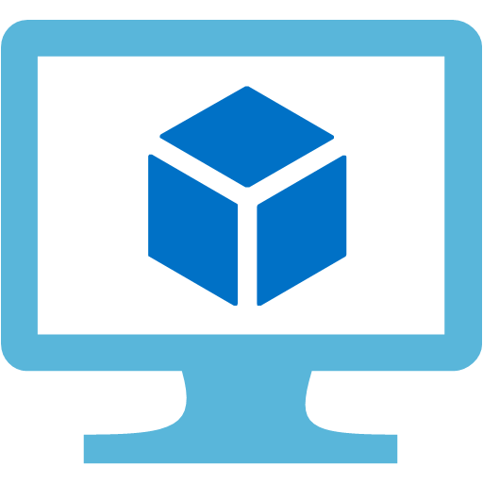
ACI Technical Model
Public IP: 40.85.154.240
Ports exposed: 80
Port 80
Port 5000
myacr.azurecr.io/app:v1
myacr.azurecr.io/sidecar:v1
acishare1
acishare2
ACI Container Group (hypervisor boundary)*
Azure VM
* Multi-container groups for Windows coming soon

Slide 44
The ACI model: billing
One-time charge for container creation: $0.0025
Per-second charge for CPU/memory requested:
1 vCPU core: $0.000013
1 GB memory: $0.000013
Examples:
Single container with 1 CPU/1 GB running for one month: $62.21
100 containers with 2 CPU/3 GB running for one hour each: $22.75

Slide 45
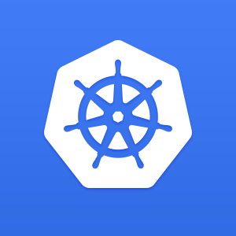
ACI Connector for Kubernetes
Enable Kubernetes clusters to deploy using ACI
Open-source on GitHub
The best of both worlds (VM and ACI)
Kubernetes
Virtual Machines
Container Instances

Slide 46
Bursting with the ACI Connector
Developers/Operators
Deployments/tasks
Kubernetes Control Plane
VM
VM
VM
Pod
Pod
Pod
Pod
Pod
Pod
Pod
Pod
Pod
Pod
Pod
Pod
Pod
Pod
Pod
Pod
Pod
Pod

Slide 47
Bursting with the ACI Connector
Developers/Operators
Deployments/tasks
Kubernetes Control Plane
AC I
CONNECT OR
ACI
Pod
Pod
Pod
Pod
Pod
Pod
VM
VM
VM
Pod
Pod
Pod
Pod
Pod
Pod
Pod
Pod
Pod
Pod
Pod
Pod
Pod
Pod
Pod
Pod
Pod
Pod
Pod
Pod
Pod
Pod
Pod
Pod
Pod
Pod
Pod
Pod
Pod
Pod

Slide 48
ACI: What you can do today
Run Linux and Windows containers
Custom CPU/memory (up to 4 CPU/8 GB memory)
Expose containers via public IP
Mount Azure files volumes for persistent storage
Set environment variables
Override the command line

Slide 49
Roadmap
Provide most standard container capabilities
Attach to an existing container
Copy files into/out of running containers
Enable ACI containers to do most things that VMs can do in Azure
Networking: Join a private vnet, sit behind an internal or external load balancer
Storage: Mount managed disks (Azure files is already available)
Invest in ACI Connector for more complex applications
Autoscaling, HA, rolling upgrades, load balancing, etc. will all be easier with an orchestrator
Developer tooling will also primarily target the orchestrator layer

Slide 50
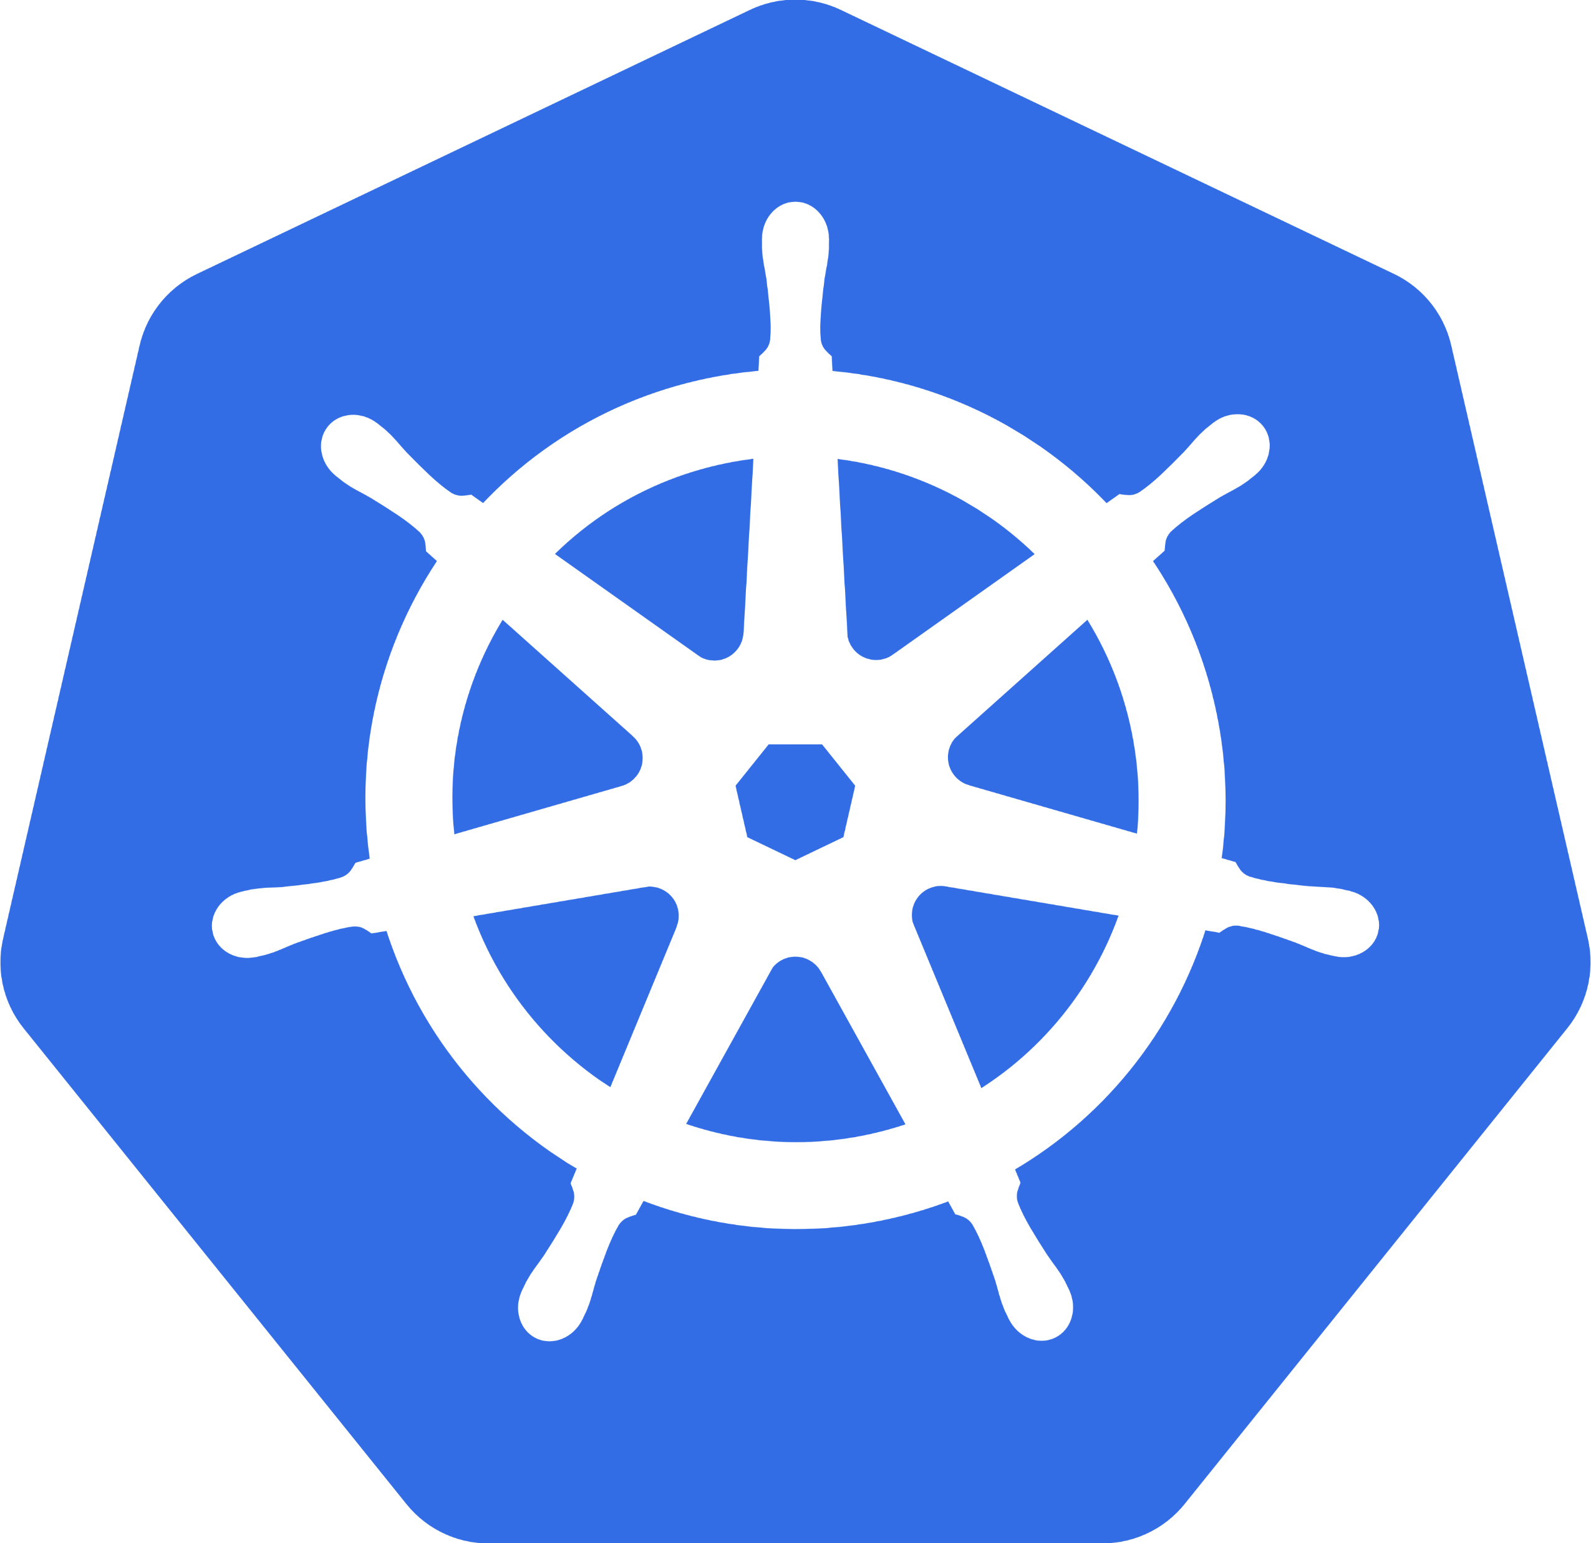
What is Kubernetes?
Background
"Kubernetes is an open-source system for automating deployment, scaling, and management of containerized applications”
Schedules and runs application containers across a cluster of machines
Kubernetes v1.0 released on July 21, 2015. Joe Beda, Brendan Burns, & Craig McLuckie
Key features
Declarative infrastructure
Self-healing
Horizontal scaling
Automated rollouts and rollbacks
Service discovery and load balancing
Automatic bin packing
Storage orchestration
Secret and configuration management
Not a PaaS platform

Slide 51
Kubernetes Architecture Components
api-server
etcd
master components
controller-manager
scheduler
kubelet
kube-proxy
node components
docker
dns

Slide 52
Kubernetes Architecture

Slide 53
Master Components
api-server: Front-end control plane. Exposes API
etcd: Cluster database. Distributed, highly available
controller-manager. Runs controllers, eg. replication controller, node controller
scheduler: assigns pods to nodes
Add-ons
DNS
Heapster. enables monitoring and performance analysis
Dashboard
Logging
Notes:
Api-server
Many different flags or switches to configure
REST interface
Etcd
Distributed, highly available key store
Written and maintained by CoreOS
Raft consensus algorithm
watches, keys, values
etcd3 standard beginning with Kubernetes 1.6
Scheduler: “Policy-rich, topology-aware, workload-specific function that significantly impacts availability, performance, and capacity”

Slide 54
Worker Node Components
kubelet:
Primary node agent
Watches and runs assigned pods
Executes health probes and reports status
kube-proxy: enables network services
docker: container engine (rkt supported experimentally)

Slide 55
kubectl: CLI to run commands against a Kubernetes cluster
Swiss Army Knife: run deployments, exec into containers, view logs, etc.
Syntax largely the same as docker
Pronounced “koob sea tee el”…
Or “koob cuddle”
Notes:
Can use –all-namespaces option with kubctl if resources can’t be found
Compatible with RBAC; can lock down namespaces
Useful for clusters that have multiple teams deploying to

Slide 56
Kubernetes Resources
pod
deployment
service
replica set
ingress
daemon set, job
namespace
secret, config-map

Slide 57
What is a pod?
Pod is the basic building block in kubernetes
Pods are how containers are delivered
Can be multiple containers (eg - side car)
Encapsulates container(s), storage, network IP, and options on how to run
Use Deployment resources to deploy
ReplicaSet
StatefulSet
DaemonSet
Job
InitContainer

Slide 58
Kubernetes manifest: Pod
apiVersion: v1
kind: Pod
metadata:
name: redis-django
labels:
app: web
spec:
containers:
- name: key-value-store
image: redis
ports:
- containerPort: 6379
- name: frontend
image: django
ports:
- containerPort: 8000
Notes:
Though pods are shown defined in yaml, they are typically deployed by other resources types such as “Deployments” explained later

Slide 59
Interact with pods
$ kubectl get po --all-namespaces
$ kubectl describe po/my-pod
$ kubectl logs my-pod
# Run bash in container
$ kubectl exec -it my-pod bash

Slide 60
Kubernetes Services
Defines a logical set of pods (your microservice)
Essentially a virtual load balancer in front of pods

Slide 61
Service Types
ClusterIP:
Exposes the service on a cluster-internal IP. Choosing this value makes the service only reachable from within the cluster
NodePort:
Exposes the service on each Node’s IP at a static port (the NodePort)
Connect from outside the cluster by requesting <NodeIP>:<NodePort>
LoadBalancer:
Exposes the service externally using a cloud provider’s load balancer

Slide 62
Kubernetes manifest: Service
apiVersion: v1
kind: Service
metadata:
name: my-service
spec:
selector:
app: web
type: ClusterIP
ports:
- protocol: TCP
port: 80
targetPort: 9376

Slide 63
Deployment
Provides declarative updates for Pods and Replica Sets
Deployment describes ”desired state”
Can:
Create deployment to rollout ReplicaSet
Declare new state for pods (eg – new imageTag)
Rollback to earlier state
Scale up/down
Check rollout history
Clean-up

Slide 64
Kubernetes manifest: Deployment
apiVersion: apps/v1beta1
kind: Deployment
metadata:
name: smackweb-deploy
spec:
replicas: 5
template:
metadata:
labels:
app: smackweb
spec:
containers:
- name: smackweb
image: chzbrgr71/smackweb
ports:
- containerPort: 8080

Slide 65
Namespaces
Allow for multiple virtual clusters backed by the same physical cluster
Logical separation
Namespace used in FQDN of Kubernetes services
Eg - <service-name>.<namespace-name>.svc.cluster.local
Every Kubernetes resource type is scoped to a namespace (except for nodes, persistentVolumes, etc.)
Intended for environments with many users, teams, projects
Notes:
Can use –all-namespaces option with kubctl if resources can’t be found
Compatible with RBAC; can lock down namespaces
Useful for clusters that have multiple teams deploying to

Slide 66
Labels and Selectors
Not related CSS…I promise
Labels are key/value pairs for any API object in Kubernetes
”Label selectors” == queries against labels to match objects
Use cases:
Associating pods to a service
Pinning workloads to specific nodes
Selecting a subset of resources

Slide 67
Optional slides…
Notes:
Can optionally use these slides (59-66) to explain the concepts in the prior kubernetes basics slides

Slide 76

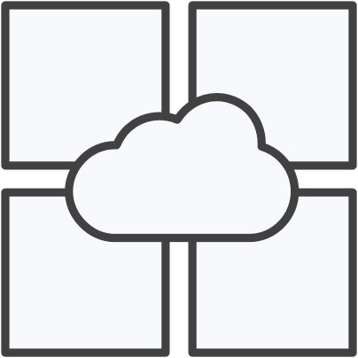

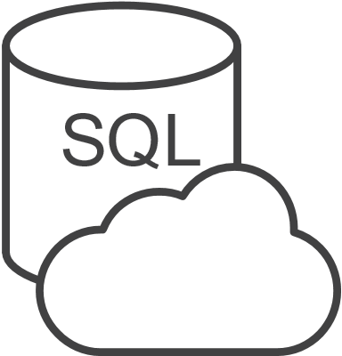

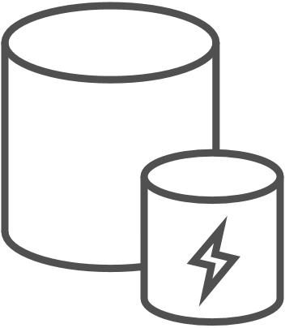
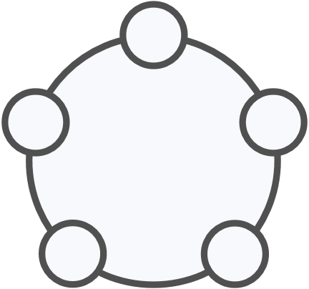
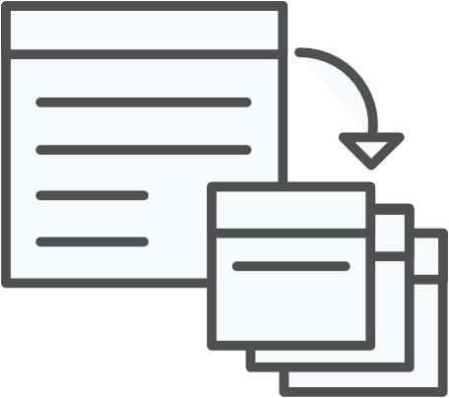



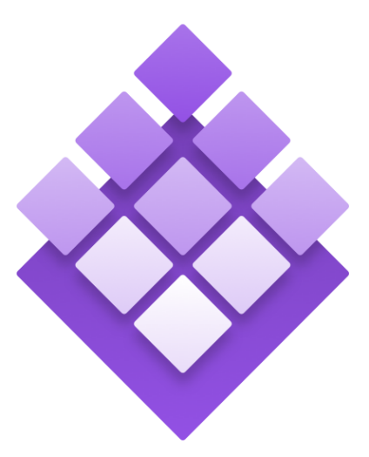
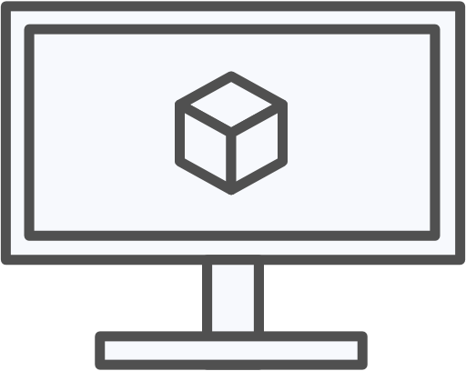
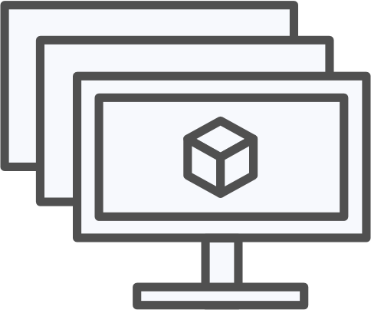
Azure Kubernetes Service (AKS)
Azure Kubernetes Service (AKS)
Azure Container Instances (ACI)
OSBA
App Service
Azure Container Registry (ACR)
Partner services
Azure services
PaaS
Azure Container Registry
OpenShift
SQL Database
Azure Kubernetes Service (AKS)
Service Fabric
Batch
Pivotal Cloud Foundry
Redis Cache
ACS Engine
Open Service Broker API (OSBA)
Docker Enterprise Edition
CosmosDB
Virtual kubelet
Mesosphere DC/OS
And more!
Azure Container Instances (ACI)
Azure Virtual Machines
Virtual Machine Scale Sets (VMSS)
Release Automation Tools
Azure
IaaS

Slide 77
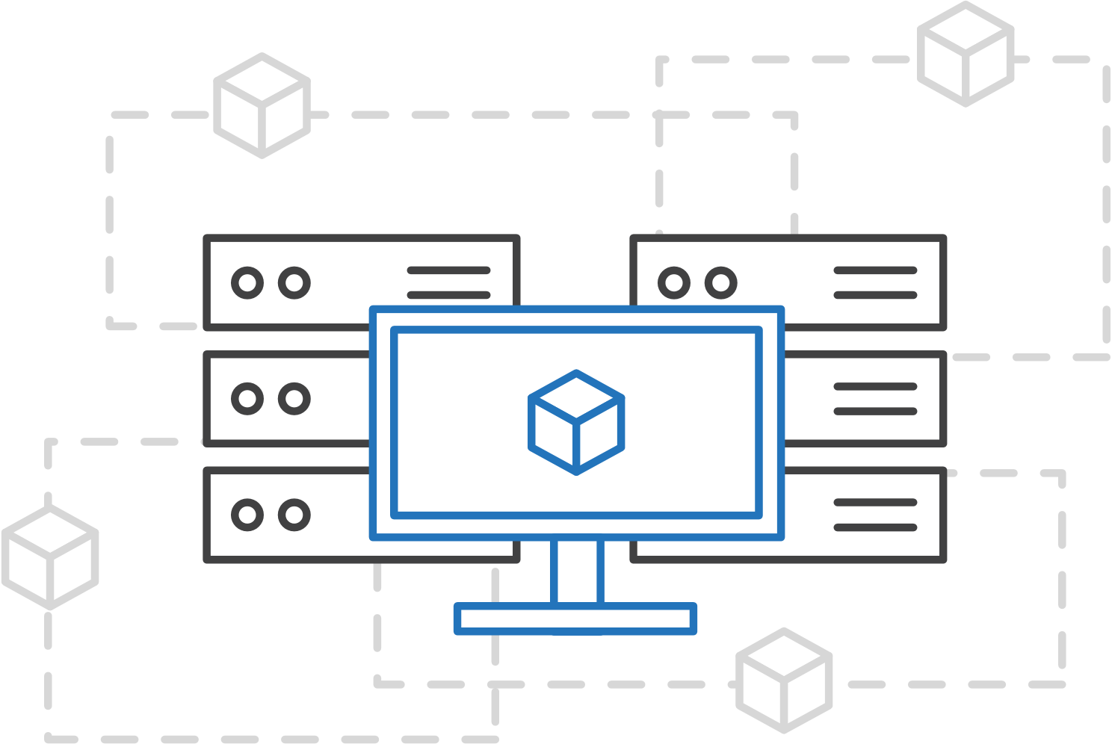
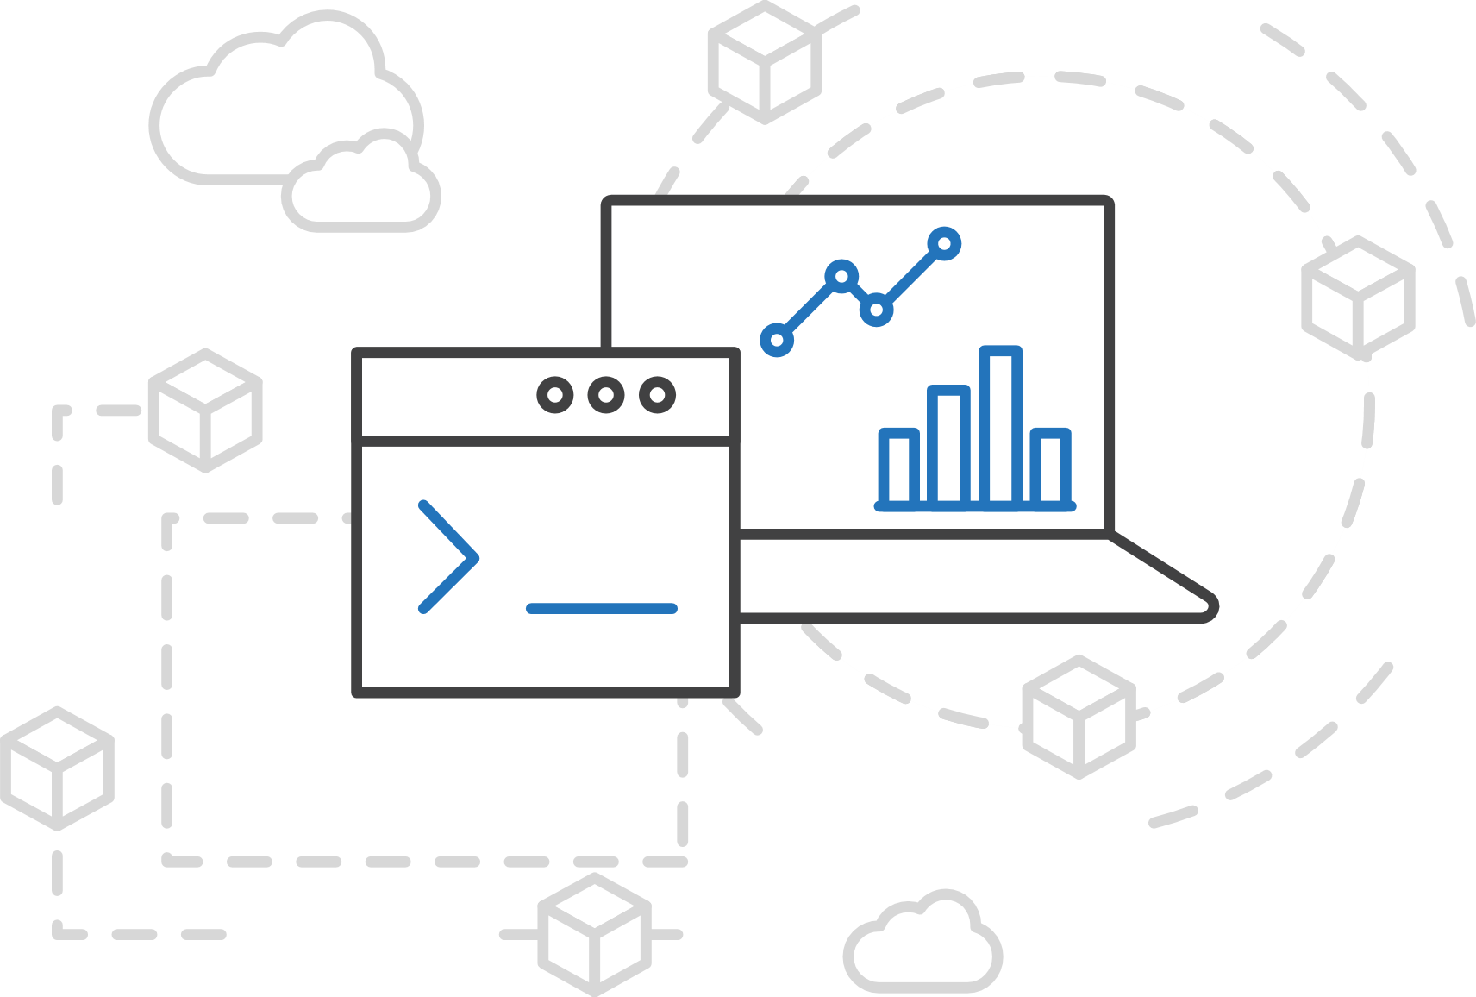
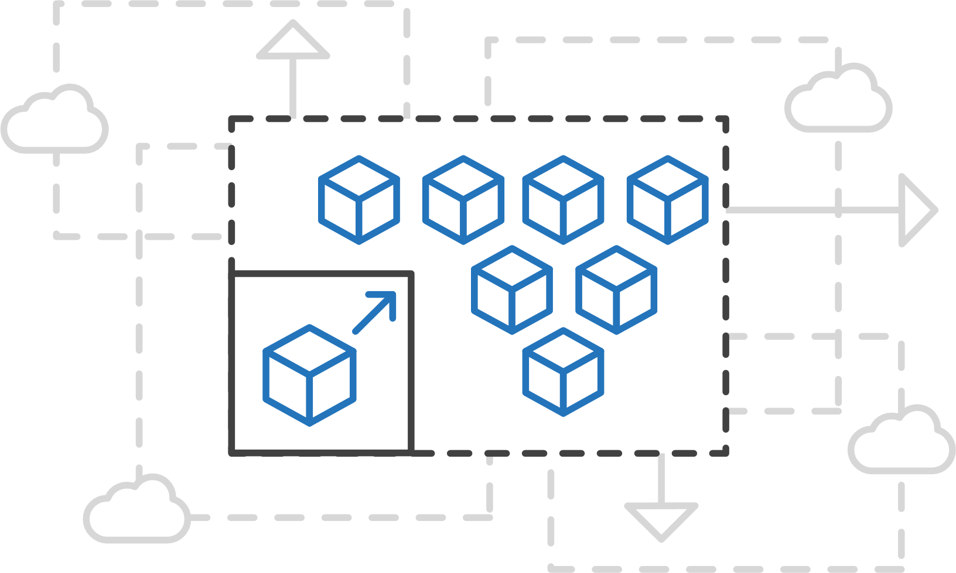
Azure Kubernetes Service (AKS)
Azure Kubernetes Service (AKS)
Simplify the deployment, management, and operations of Kubernetes
Azure Container Instances (ACI)
Azure Container Registry
Open Service Broker API (OSBA)
Focus on your containers not the infrastructure
Work how you want with open-source APIs
Scale and run applications with confidence
Release Automation Tools

Slide 78
Azure Kubernetes Service (AKS)
Azure Kubernetes Service (AKS)
A fully managed Kubernetes cluster
Azure Container Instances (ACI)
Managed control pane
Automated upgrades, patches
Easy cluster scaling
Self-healing
Cost savings
Azure Container Registry
Managed
Application architect
Applications
Open Service Broker API (OSBA)
Operations
Kubernetes
Infrastructure architect
Docker
Release Automation Tools
Azure infrastructure services

Slide 79
Azure Kubernetes Service (AKS)
Azure Kubernetes Service (AKS)
Get started easily
Azure Container Instances (ACI)
$ az aks create -g myResourceGroup -n myCluster --generate-ssh-keys
\ Running ..
$ az aks install-cli
Downloading client to /usr/local/bin/kubectl ..
$ az aks get-credentials -g myResourceGroup -n myCluster
Merged "myCluster" as current context ..
$ kubectl get nodes
NAME STATUS AGE VERSION
aks-mycluster-36851231-0 Ready 4m v1.8.1
aks-mycluster-36851231-1 Ready 4m v1.8.1
aks-mycluster-36851231-2 Ready 4m v1.8.1
Azure Container Registry
Open Service Broker API (OSBA)
Release Automation Tools

Slide 80
Azure Kubernetes Service (AKS)
Azure Kubernetes Service (AKS)
Manage an AKS cluster
Azure Container Instances (ACI)
$ az aks list –o table
Name Location ResourceGroup KubernetesRelease ProvisioningState
------------------ ---------- -------------- ------------------- -------------------
myCluster westus2 myResourceGroup 1.7.7 Succeeded
$ az aks upgrade -g myResourceGroup -n myCluster –-kubernetes-version 1.8.1
\ Running ..
$ kubectl get nodes
NAME STATUS AGE VERSION
aks-mycluster-36851231-0 Ready 12m v1.8.1
aks-mycluster-36851231-1 Ready 8m v1.8.1
aks-mycluster-36851231-2 Ready 3m v1.8.1
$ az aks scale -g myResourceGroup -n myCluster --agent-count 10
\ Running ..
Azure Container Registry
Open Service Broker API (OSBA)
Release Automation Tools

Slide 81
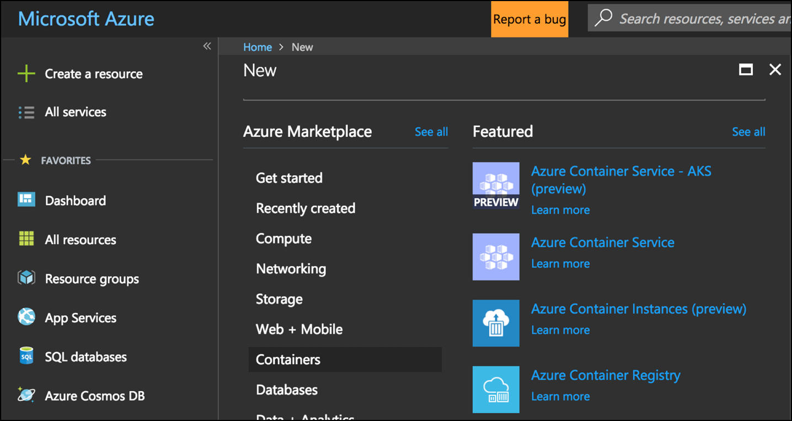
Azure Kubernetes Service (AKS)
Azure Kubernetes Service (AKS)
Create AKS via Portal, Azure CLI, or ARM template
Azure Container Instances (ACI)
Azure Container Registry
Open Service Broker API (OSBA)
Release Automation Tools

Slide 82
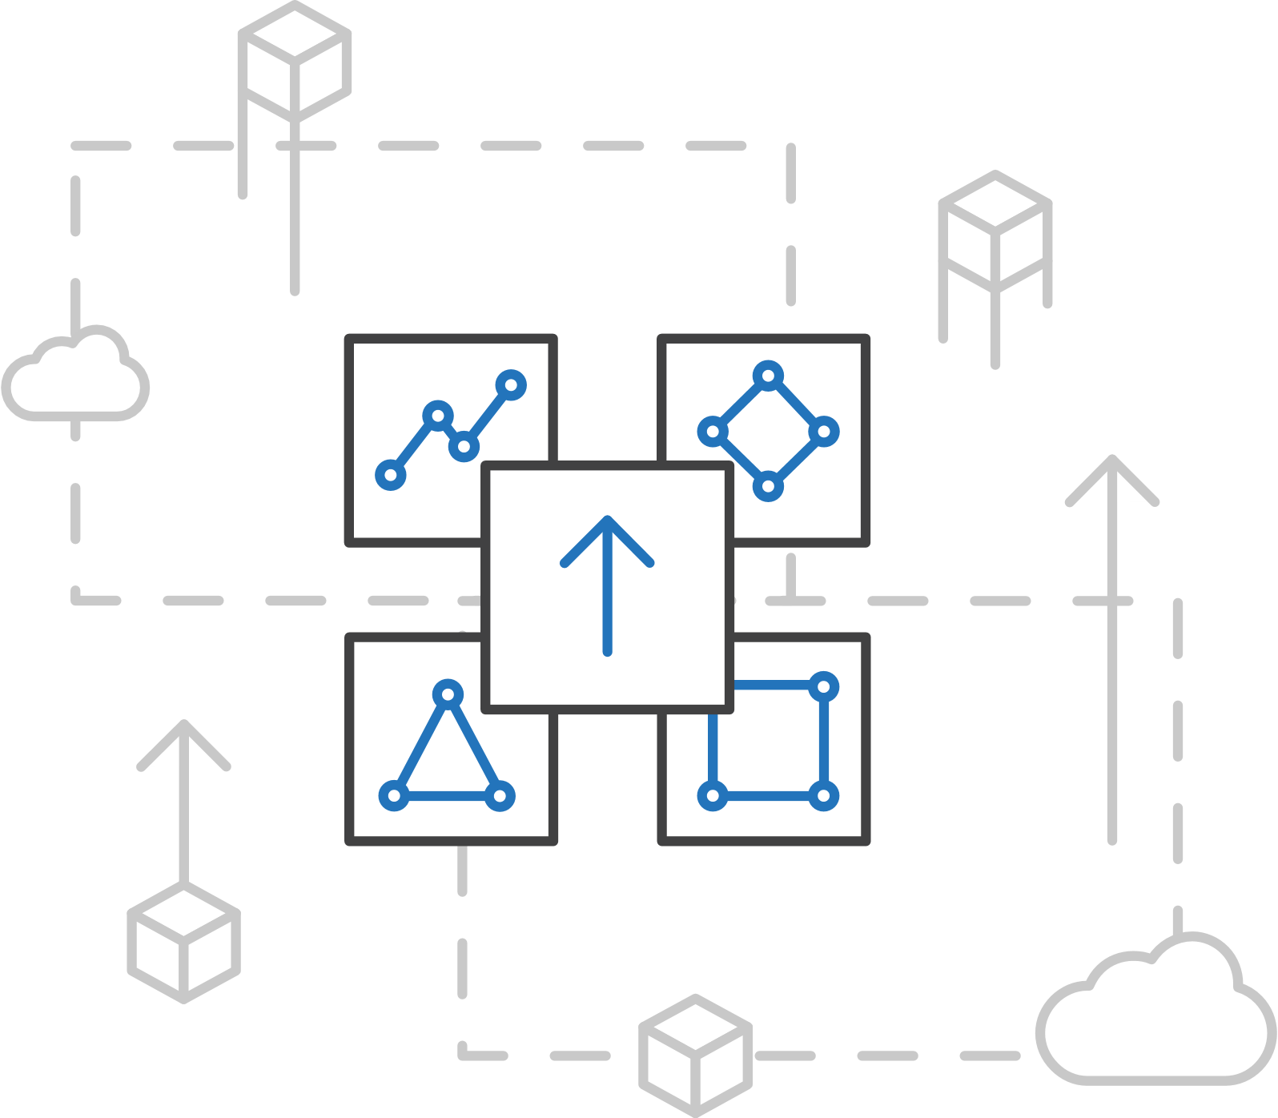
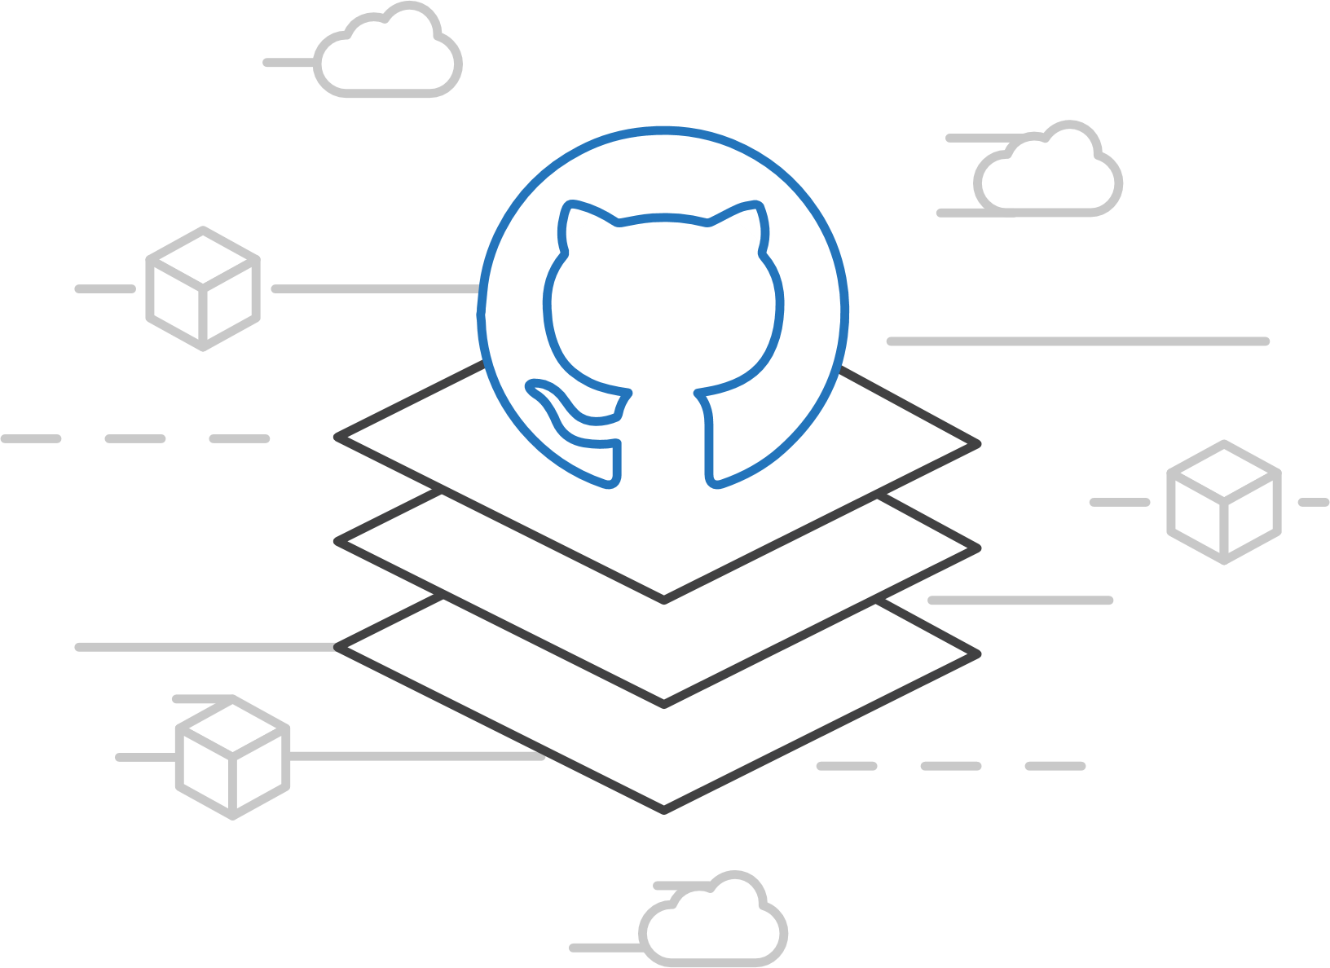
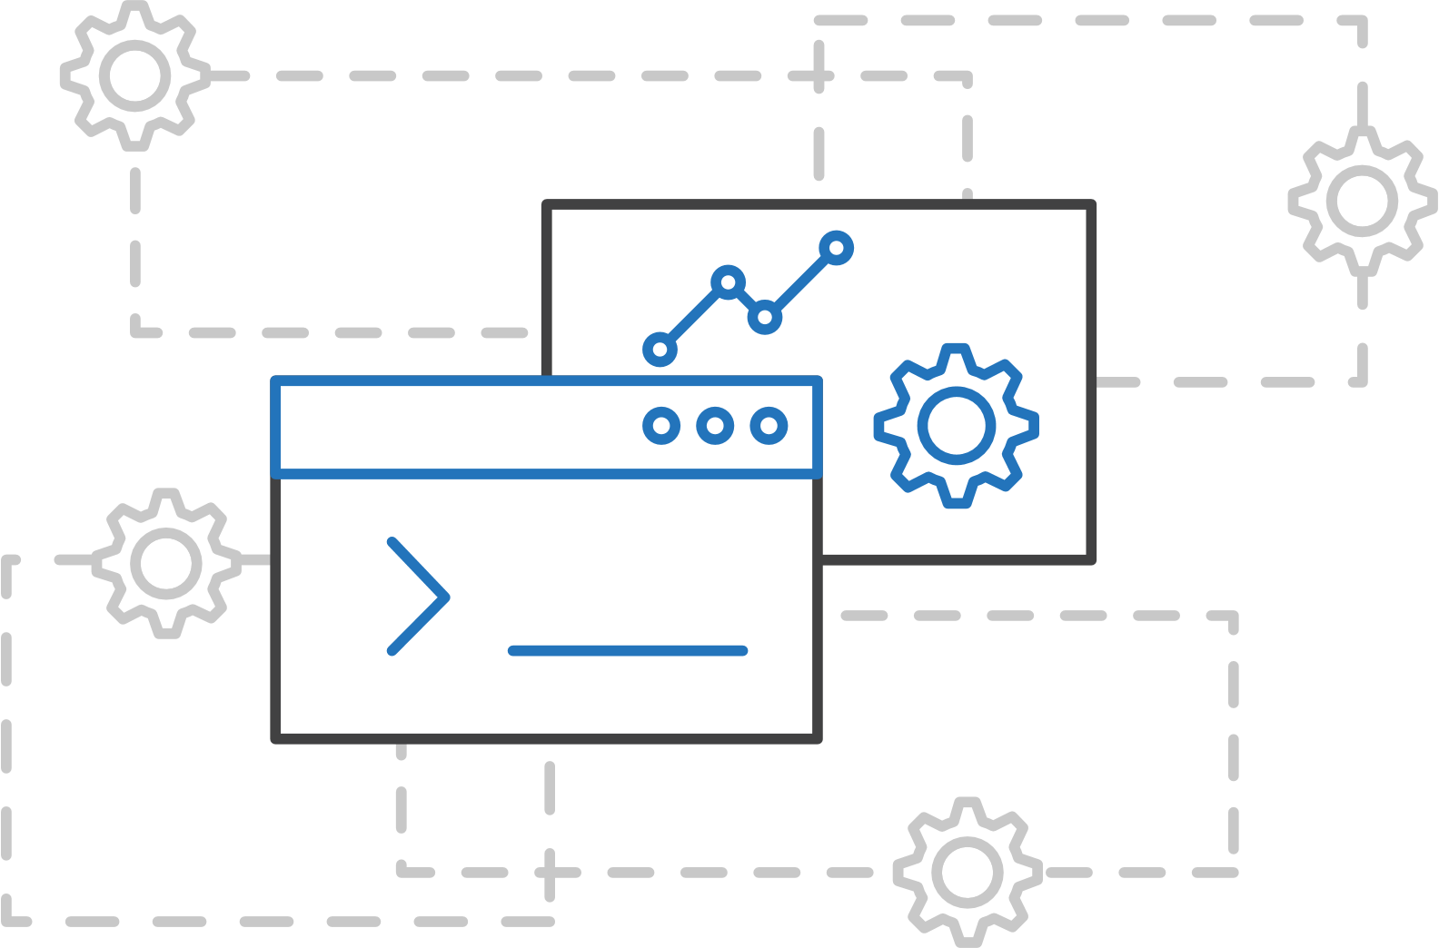
ACS Engine
Azure Kubernetes Service (AKS)
Customized Kubernetes on Azure
Azure Container Instances (ACI)
Azure Container Registry
Open Service Broker API (OSBA)
A proving ground for new features
Enables custom deployments
Available on GitHub
Release Automation Tools

Slide 83
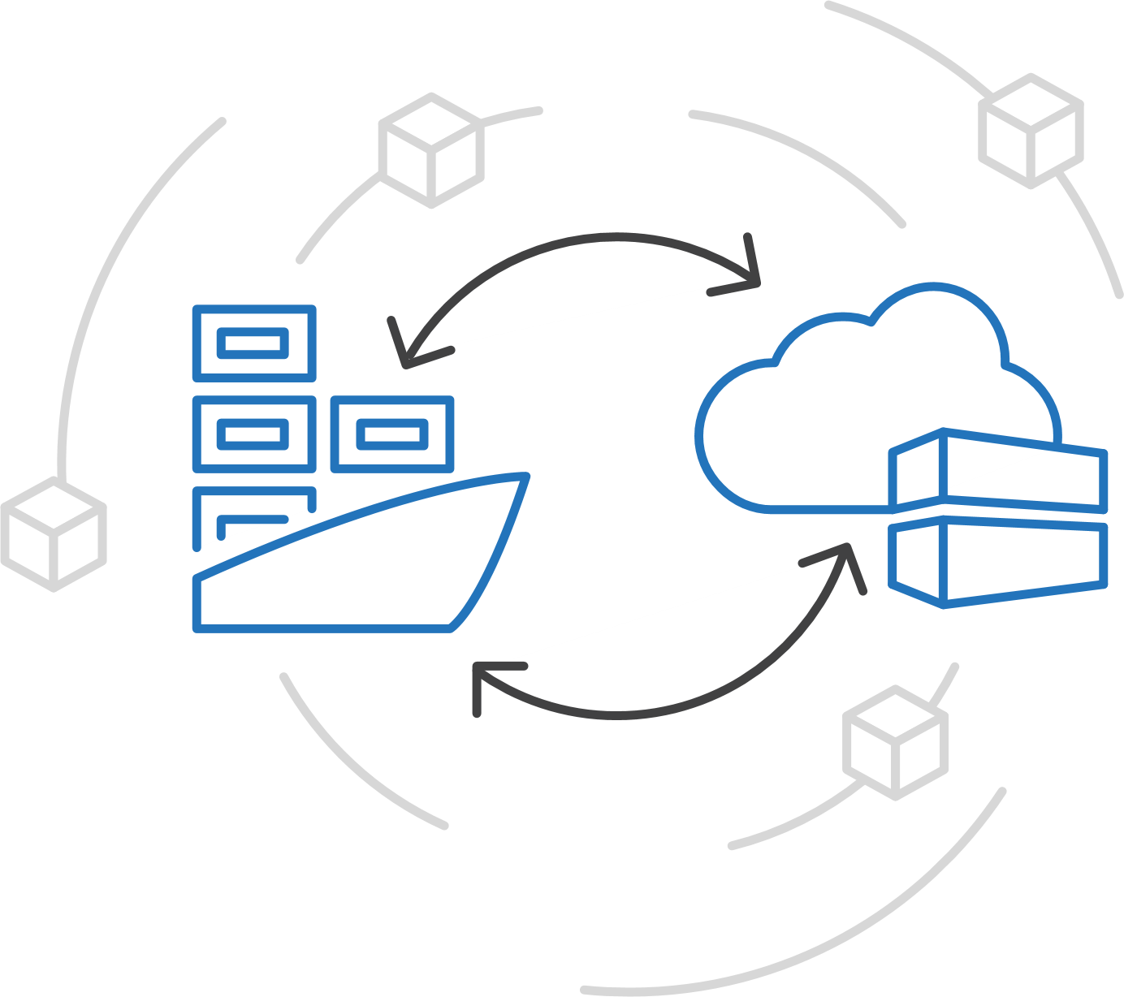
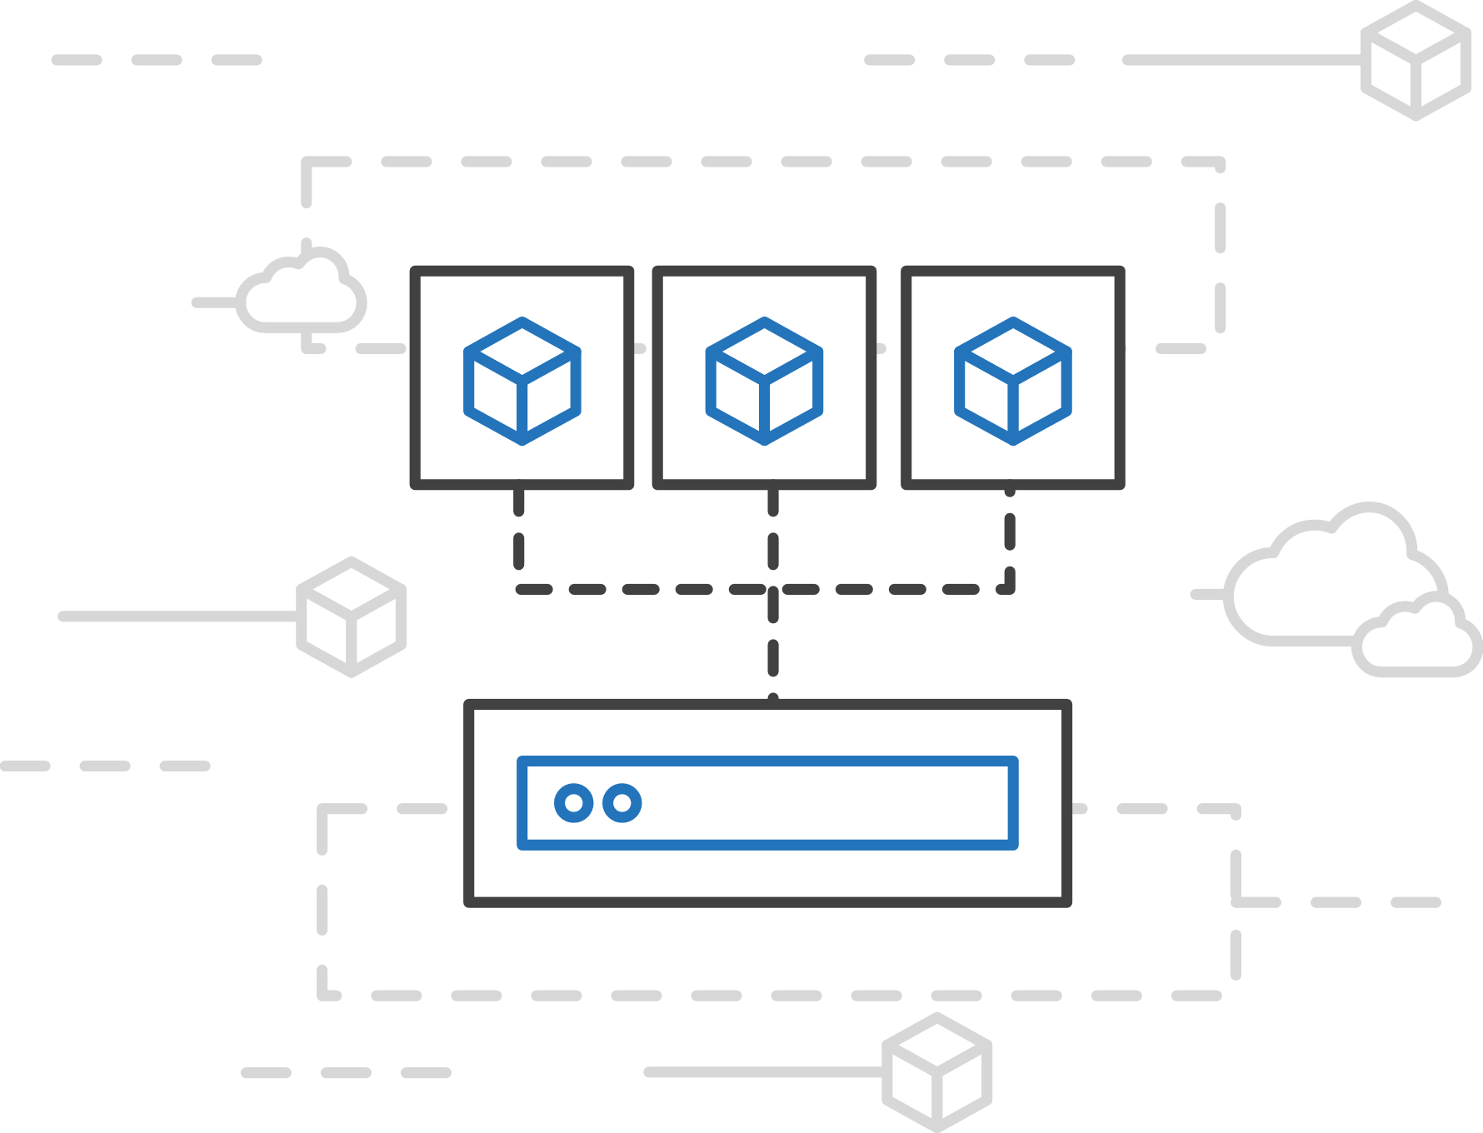
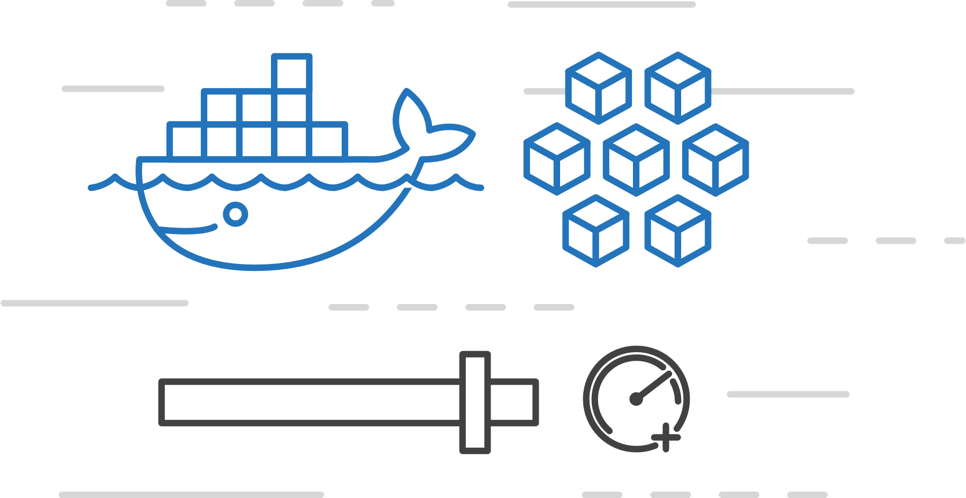
Azure Container Instances (ACI)
Azure Kubernetes Service (AKS)
PREVIEW
Easily run containers on Azure with a single command
Azure Container Instances (ACI)
Azure Container Registry
Open Service Broker API (OSBA)
Start using containers right away
Cloud-scale container capacity
Hyper-visor isolation
Release Automation Tools

Slide 84
Azure Container Instances (ACI)
Azure Kubernetes Service (AKS)
PREVIEW
Get started easily
Azure Container Instances (ACI)
$ az container create --name mycontainer --image microsoft/aci-helloworld --resource-group myResourceGroup --ip-address public
"ipAddress": {
"ip": "52.168.86.133",
"ports": [...]
},
"location": "eastus",
"name": "mycontainer",
"osType": "Linux",
"provisioningState": "Succeeded",
$ curl 52.168.86.133
<html>
<head>
<title>Welcome to Azure Container Instances!</title>
</head>
Azure Container Registry
Open Service Broker API (OSBA)
Release Automation Tools

Slide 85
Azure Container Instances (ACI)
Azure Kubernetes Service (AKS)
PREVIEW
Create an Azure Container Instance quickly
Azure Container Instances (ACI)
Azure Container Registry
Open Service Broker API (OSBA)
Release Automation Tools

Slide 86
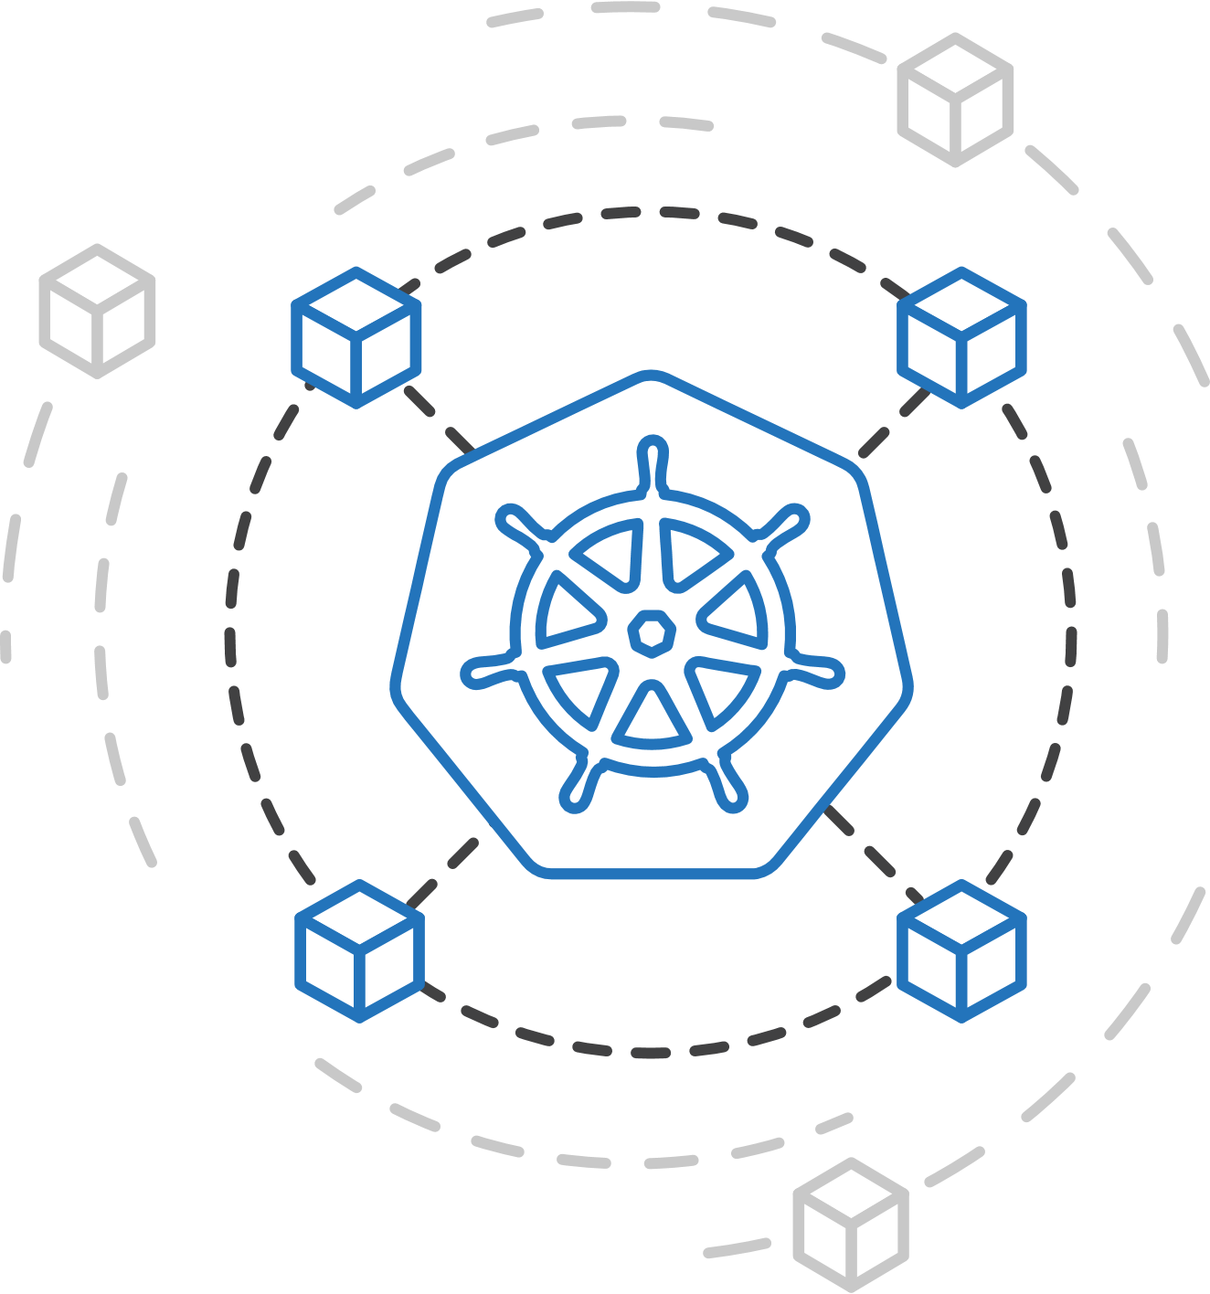
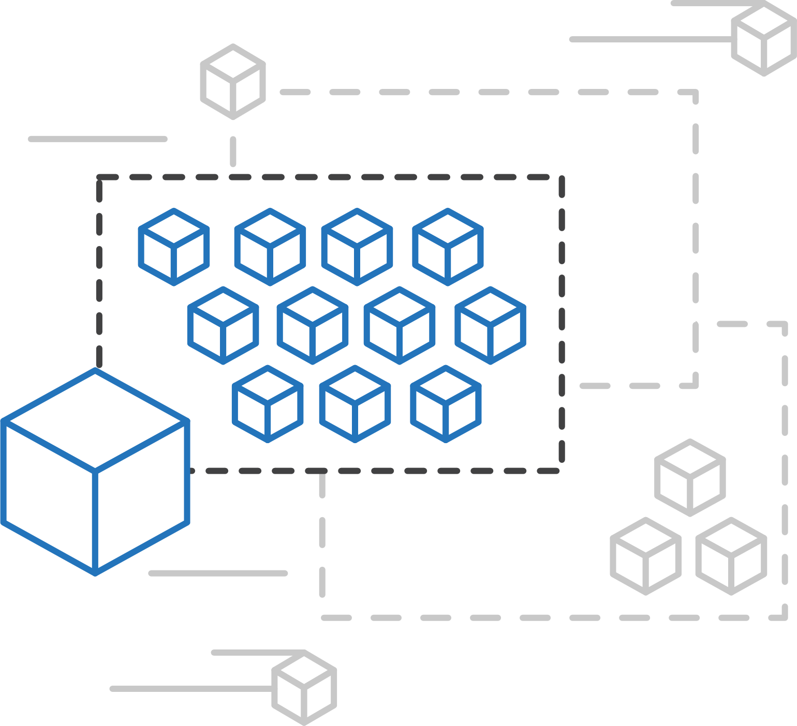
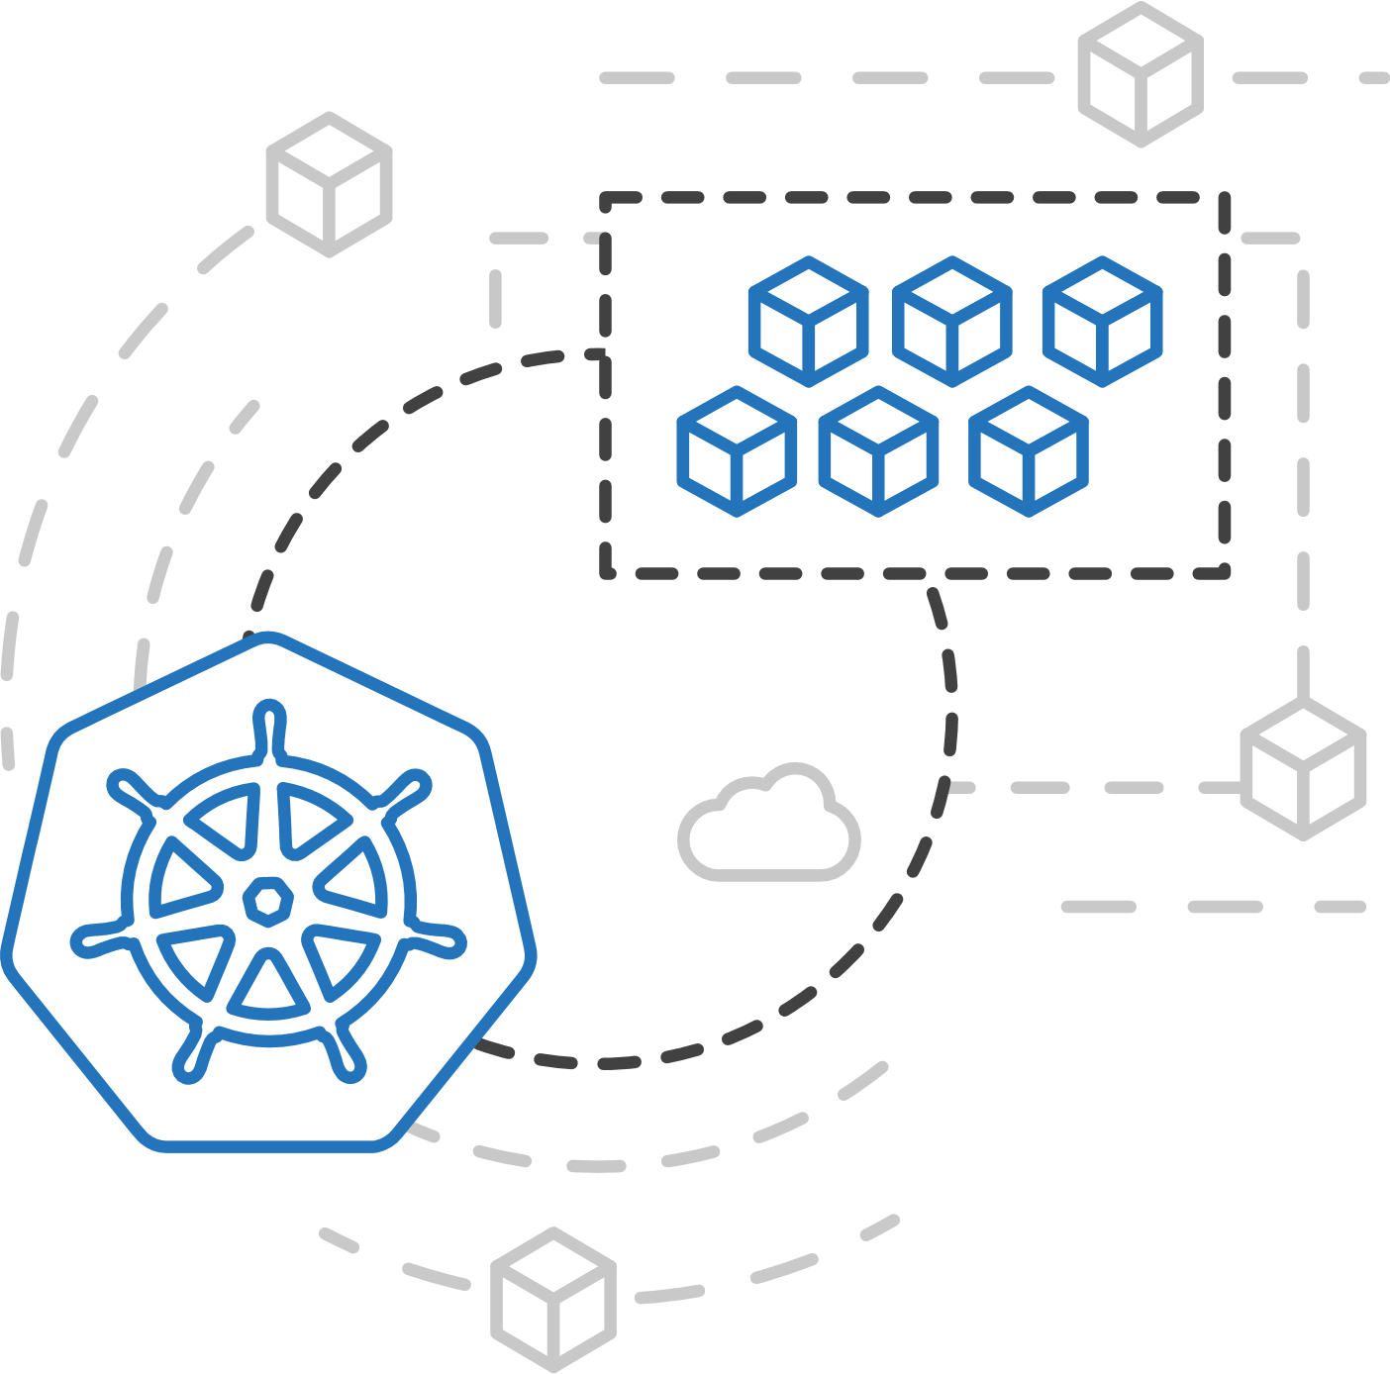
Azure Kubernetes Service (AKS)
Azure Container Instances (ACI)
PREVIEW
ACI Connector for Kubernetes
Azure Container Instances (ACI)
Azure Container Registry
Open Service Broker API (OSBA)
Kubernetes provides rich orchestration capabilities
ACI provides infinite container-based scale
The ACI Connector for K8s brings them together
Release Automation Tools

Slide 87
Azure Container Instances (ACI)
Azure Kubernetes Service (AKS)
PREVIEW
Bursting with the ACI Connector
Azure Container Instances (ACI)
VM
VM
Pod
Waste
Pod
Pod
Pod
Waste
Pod
Pod
Pod
Pod
Azure Container Registry
Azure Container Instances (ACI)
Pod
Pod
Pod
Pod
Pod
Application architect
Kubernetes control pane
ACI Connector
Pod
Pod
Pod
Pod
Pod
Pod
Pod
Pod
Pod
Pod
Open Service Broker API (OSBA)
Pod
Pod
Pod
Pod
Pod
Deployment/ tasks
Pod
Pod
Pod
Pod
Pod
Infrastructure architect
Release Automation Tools
Pod
Waste
Pod
Pod
Pod
Waste
Pod
Pod
Pod
Pod
VM
VM

Slide 88
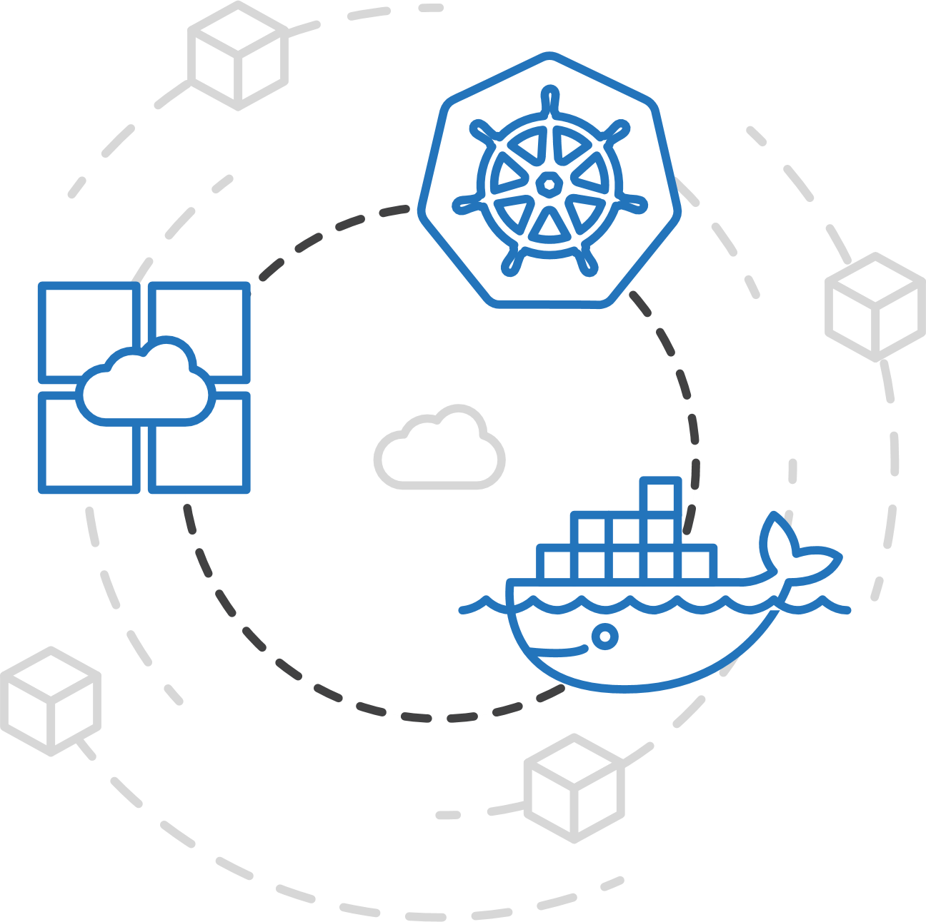
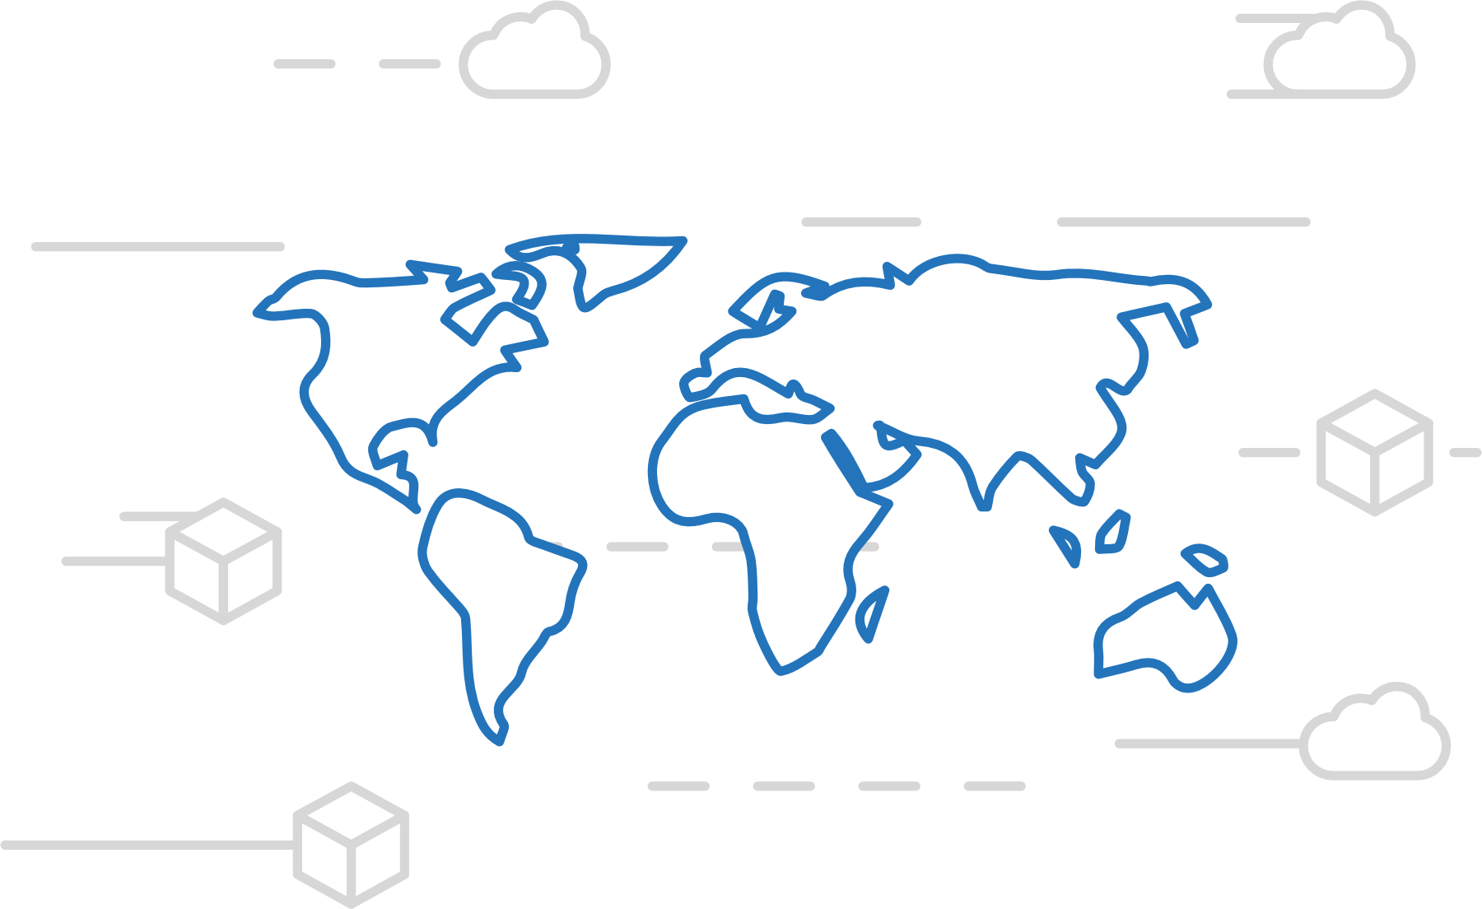
Azure Container Registry
Azure Kubernetes Service (AKS)
Manage a Docker private registry as a first-class Azure resource
Azure Container Instances (ACI)
Azure Container Registry
Open Service Broker API (OSBA)
Manage images for all types of containers
Use familiar, open-source Docker CLI tools
Azure Container Registry geo-replication
Release Automation Tools

Slide 89
Azure Container Registry
Azure Kubernetes Service (AKS)
Create a container in the Registry quickly
Azure Container Instances (ACI)
Azure Container Registry
Open Service Broker API (OSBA)
Release Automation Tools

Slide 90

Open Service Broker for Azure (OSBA)
Azure Kubernetes Service (AKS)
Azure Container Instances (ACI)
OSBA
App Service
Azure Container Registry (ACR)
Partner services
Azure services
PaaS
Azure Container Registry
OpenShift
SQL Database
Azure Kubernetes Service (AKS)
Service Fabric
Batch
Pivotal Cloud Foundry
Redis Cache
ACS Engine
Open Service Broker API (OSBA)
Docker Enterprise Edition
CosmosDB
Virtual kubelet
Mesosphere DC/OS
And more!
Azure Container Instances (ACI)
Azure Virtual Machines
Virtual Machine Scale Sets (VMSS)
Release Automation Tools
Azure
IaaS

Slide 91
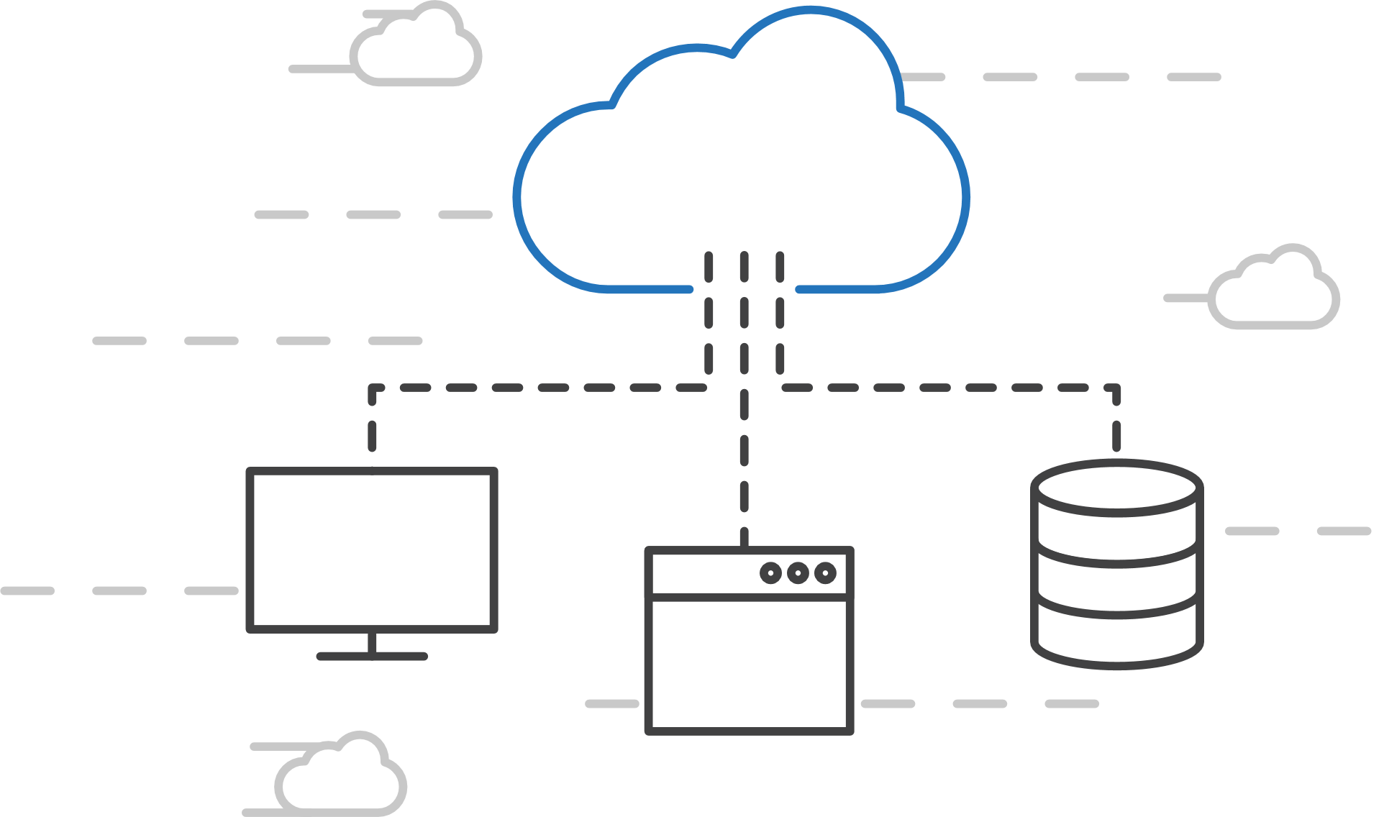
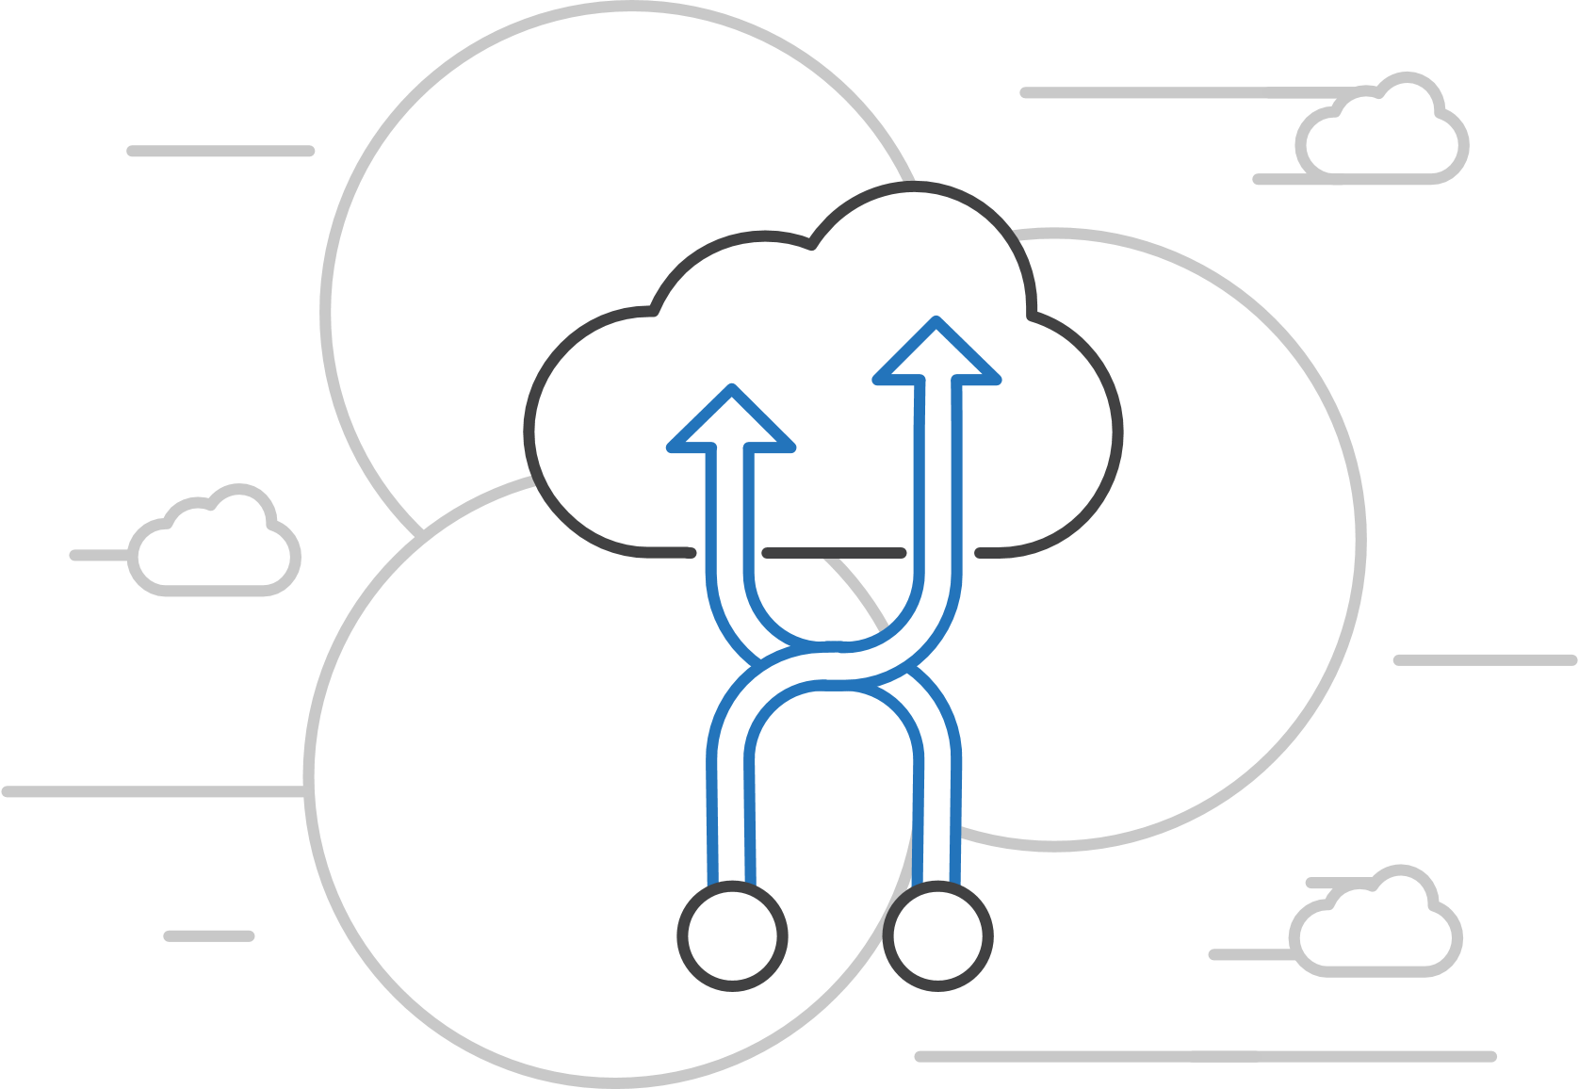
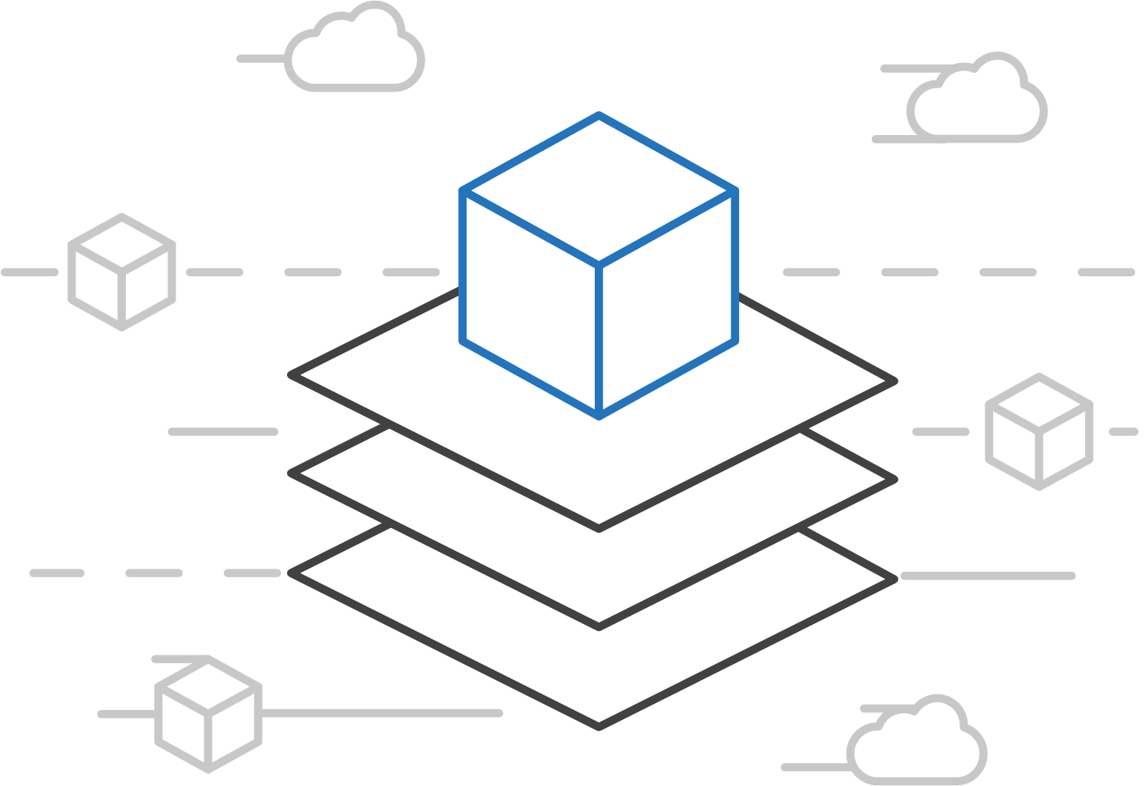
Open Service Broker for Azure (OSBA)
Azure Kubernetes Service (AKS)
Connecting containers to Azure services and platforms
Azure Container Instances (ACI)
Azure Container Registry
Open Service Broker API (OSBA)
A standardized way to connect with Azure services
Simple and flexible service integration
Compatible across numerous platforms
Release Automation Tools

Slide 92
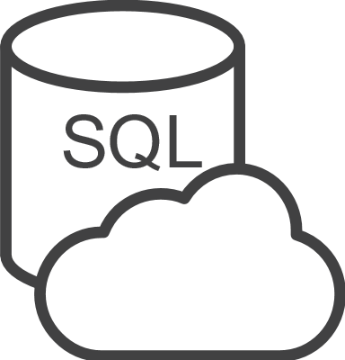




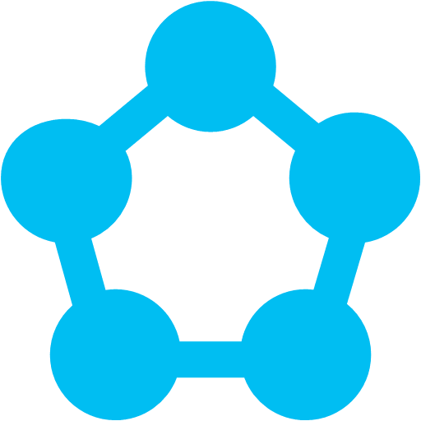
Open Service Broker for Azure (OSBA)
Azure Kubernetes Service (AKS)
An implementation of the Open Service Broker API
Azure Container Instances (ACI)
Azure SQL Database
Redis Cache
CosmosDB
And more!
Azure Container Registry
Open Service Broker for Azure (OSBA)
Open Service Broker API (OSBA)
Release Automation Tools
OpenShift
Cloud Foundry
Service Fabric (Coming soon)
Kubernetes (AKS)

Slide 93
Networking

Slide 94
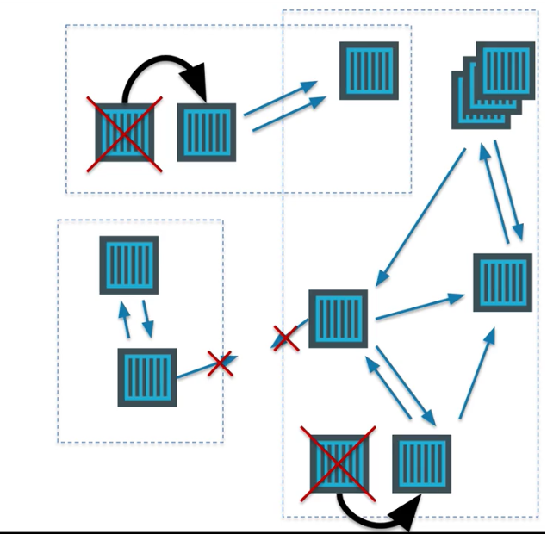
Networking in the Container World

Slide 95



Multi-Host Networking
Agent1
Agent2
eth0 : 10.0.0.6
eth0 : 10.0.0.8
docker0 : 172.17.0.1
docker0 : 172.17.0.1
eth0 : 172.17.0.3
eth0 : 172.17.0.3
eth0 : 172.17.0.4
eth0 : 172.17.0.4
vethxxx
vethxxx
vethxxx
vethxxx

Slide 96




Multi-Host Networking
Agent1
key/value
store
Agent2
eth0 : 10.0.0.6
eth0 : 10.0.0.8
docker0 : 172.17.0.1
docker0 : 172.17.0.1
192.168.0.0/24
eth0 : 192.168.0.1
eth0 : 192.168.0.3
eth0 : 192.168.0.2
eth0 : 192.168.0.4
vethxxx
vethxxx
vethxxx
vethxxx

Slide 97

Networking in Kubernetes
Kubernetes Networking model introduces 3 methods of communications:
Pod-to-Pod communication directly by IP address. Kubernetes has a Pod-IP wide metric simplifying communication.
Pod-to-Service Communication – Client traffic is directed to service virtual IP by iptables rules that are modified by the kub-proxy process (running on all hosts) and directed to the correct Pod.
External-to-Internal Communication – external access is captured by an external load balancer which targets nodes in a cluster. The Pod-to-Service flow stays the same.
Notes:
When the backend Service is created, the Kubernetes master assigns a virtual IP address, for example 10.0.0.1. Assuming the Service port is 1234, the Service is observed by all of the kube-proxy instances in the cluster. When a proxy sees a new Service, it installs a series of iptables rules which redirect from the VIP to per-Service rules. The per-Service rules link to per-Endpoint rules which redirect (Destination NAT) to the backends.
When a client connects to the VIP the iptables rule kicks in. A backend is chosen (either based on session affinity or randomly) and packets are redirected to the backend. Unlike the userspace proxy, packets are never copied to userspace, the kube-proxy does not have to be running for the VIP to work, and the client IP is not altered.
This same basic flow executes when traffic comes in through a node-port or through a load-balancer, though in those cases the client IP does get altered.

Slide 98
Service Discovery

Slide 99
What is service discovery?
Problem: How service can find and communicate with another one running into the same cluster?
Service Registry/Naming Service
Service Announcement
Lookup/Discovery
Load Balancing
?!?

Slide 100

Service Discovery with Kubernetes
Nodes, Deployments, Pods, Services
Services
Expose the services
Works with platform Load Balancers to get public IPs
Internal load balancing between pods
kube-dns (preferred)
Name service enabled in Kubernetes (Default in ACS)
Environment Variables
Every Service is assigned environment variables with information of the service
REDIS_MASTER_SERVICE_HOST=10.0.0.11 REDIS_MASTER_SERVICE_PORT=6379 REDIS_MASTER_PORT=tcp://10.0.0.11:6379 REDIS_MASTER_PORT_6379_TCP=tcp://10.0.0.11:6379 REDIS_MASTER_PORT_6379_TCP_PROTO=tcp REDIS_MASTER_PORT_6379_TCP_PORT=6379 REDIS_MASTER_PORT_6379_TCP_ADDR=10.0.0.11
Source: https://kubernetes.io/docs/tutorials/kubernetes-basics/expose-intro/
Notes:
NOTE ON ENVIRONMENT VARIABLES: This does imply an ordering requirement - any Service that a Pod wants to access must be created before the Pod itself, or else the environment variables will not be populated. DNS does not have this restriction.

Slide 101
Ingresses
Typically, services and pods have IPs only routable by the cluster network
Ingress is a collection of rules that allow inbound connections to reach the cluster services
Gives you a way to route requests to services based on the request host or path, centralizing a number of services into a single entrypoint
Allows you to configure multiple Virtual Hosts, Sticky sessions, Path rewrites and also custom configs, providing a powerful, flexible routing mechanism for Kubernetes.
Notes:
I
Pods won’t survive scheduling failures, node failures, or other evictions, such as due to lack of resources, or in the case of node maintenance.

Slide 102
Ingresses
apiVersion: extensions/v1beta1
kind: Ingress
metadata:
name: my-ingress
spec:
rules:
- host: www.mysite.com
http:
paths:
- backend:
serviceName: website
servicePort: 80
- host: forums.mysite.com
http:
paths:
- path:
backend:
serviceName: forums
servicePort: 80
Notes:
I
Pods won’t survive scheduling failures, node failures, or other evictions, such as due to lack of resources, or in the case of node maintenance.

Slide 103

Ingress Controllers
An Ingress controller is responsible for fulfilling the Ingress, usually with a loadbalancer, though it may also configure your edge router or additional frontends to help handle the traffic in an HA manner
Can technically be any system capable of reverse proxying
Common Ingress Controllers
Nginx
HAProxy
Notes:
I
Pods won’t survive scheduling failures, node failures, or other evictions, such as due to lack of resources, or in the case of node maintenance.

Slide 104
Container Network Interface (CNI)
CNI (a CNCF project) is a spec for plugins to configure Linux container network interfaces
Wide range of support
Kubernetes, OpenShift, Cloud Foundry, Mesos, rkt, etc.
Examples
Calico, Weave, Contiv, etc.
Azure CNI plug-in integrates Azure VNET into kubernetes clusters
Use acs-engine
Notes:
CNCF = Cloud Native Computing Foundation
https://github.com/Azure/azure-container-networking/blob/master/docs/acs.md

Slide 105
Configuration

Slide 106
ConfigMaps and Secrets
Flexible configuration model for Kubernetes
Both Secrets and ConfigMaps can be used as ENV vars or files
Secrets
Use Secrets for things which are actually secret like API keys, credentials, etc
Secret values are base64 encoded and automatically decoded for pods
ConfigMaps
ConfigMaps for configuration that doesn’t have sensitive information. However, there are pros/cons with each
ConfigMaps designed to more conveniently support working with strings
Notes:
Decouple configuration artifacts from image content to keep containerized applications portable

Slide 107
DevOps & CI / CD

Slide 108
DevOps Practices Arrive
Developers: Test, Build, Code, Plan
Operations: Monitor, Release, Deploy, Operate
DevOps Features
Speed of application delivery/updates
Faster time to value
Repeatable/consistent
Automated testing
Traceability of process
Applying developer patterns to infrastructure
Infrastructure as code
Ops teams embracing source control
Centralized monitoring, logging, debugging
CI / CD – key aspect of quality DevOps

Slide 109

DevOps – Why you care
Deploy 200 times more frequently
Go from code check-in to production 2,555 times faster
Recover from failure 24 times faster
Spent 50% less time remediating security challenges
Spent 22% less time on unplanned work
2.2 times more likely to believe their places a great place to work
Source: https://puppet.com/resources/white-paper/2016-state-of-devops-report

Slide 110
Common Toolsets
Jenkins
Visual Studio Team Services
Spinnaker and Netflix OSS
Travis
TeamCity
CircleCI
Additional utilities: code quality scanning, security, collaboration, etc.

Slide 111
Enter Helm: Kubernetes Package Manager
Notes:
Similar to apt-get on Linux, Homebrew on MacOS, or Chocolatey on Windows

Slide 112
Birth of Helm
On October 15th, 2015
Hackathon project at company offsite
Could we take the ideas behind npm and Homebrew and build something for deploying apps into Kubernetes?
Installation tool for Deis Workflow
Announced at the first KubeCon in San Francisco 2015

Slide 113
Helm Charts
Application definition
Consists of:
Metadata
Kubernetes resource definitions
Configuration
Documentation
Stored in chart repository
Any HTTP server that can house YAML/tar files (Azure, GitHub pages, etc.)
Public repo with community supported charts (eg – Jenkins, Mongo, etc.)
Helm (CLI) + Tiller (sever side)
Release: Instance of chart + values -> Kubernetes

Slide 115
Chart structure
Charts have structure
Set of conventions, including file and directory names
Charts can be packaged into tarballs for distribution

Slide 116

Chart structure
Layout
Helm expects a strict chart structure

Slide 117

Chart.yaml

Slide 118
Helm values.yaml
The knobs and dials:
A values.yaml file provided with the chart that contains default values
Use -f to provide your own values overrides
Use --set to override individual values

Slide 119
Helm Templates
Built on Go’s template language w/addition of 50 or so add-on template functions
Almost anything goes! ;-)
Also useful in generating random values (e.g. passwords)
Provides flow control (if/else, with, range, etc)
Named templates (partials)

Slide 120
Draft: Streamlined Kubernetes Development
What is draft?
Developer workstations cannot mimic production
As devs hack on code prior to committing to version control
Draft targets the "inner loop" of a developer's workflow
Works with other Deis tools such as Helm and Workflow
Developer Workstation
Dev (Inner Loop)
Production / Staging Cluster
Notes:
Draft is an open source tool.

Slide 121
Storage

Slide 122
Volumes
On-cluster representation of physical storage
Lifetime of Volume object itself tied to the pod that encloses it—when the pod is gone, the Volume is gone
Can persist data
PersistentVolume: a disk
PersistentVolumeClaim: dynamically provision a disk
StorageClass: cluster consumers can request storage without needing intimate knowledge about underlying storage volume sources

Slide 123
Other neat volume-y things
Mount a Secret or ConfigMap as a volume in a pod
Useful for passing around TLS certificates
Mount a git repo as a volume

Slide 124
Supported Volume Types
emptyDir
hostPath
gcePersistentDisk
awsElasticBlockStore
nfs
iscsi
azureFileVolume
azureDisk
vsphereVolume
fc (fibre channel)
flocker
glusterfs
rbd
Cephfs
Quobyte
PortworxVolume
ScaleIO

Slide 125
Scaling

Slide 126
Autoscaling Strategies
Infrastructure Level
Increase/decrease the number of nodes running in the cluster
Azure infrastructure function
VM Scalesets (DCOS/Docker), Availability Sets (Kubernetes)
No auto-scaling in ACS today
Application Level
Increase/decrease the number of containers for a given service
Handled by the orchestrator or the application itself
Kubernetes Horizontal Pod Autoscaling
These functions should be coordinated

Slide 127
Scaling the ACS Cluster

Slide 128
Scaling Kubernetes from within
acs-engine-autoscaler is a node-level autoscaler for Kubernetes for clusters created with acs-engine.
Pre-requisites:
Kubernetes Cluster deployed using ACS-Engine
Service Principal with RBAC access to RG
kubeconfigprivatekey, clientprivatekey and caprivatekey from azuredeploy.parameters.json file
Helm tiller running on k8s Cluster
Notes:
Note that this could be considered an “anti-pattern”

Slide 129
Application Health and Readiness
Kubelets on workers use liveness and readiness probes to know when to restart a container or start directing traffic
Liveness check: when to restart
Readiness check: when to forward Service traffic to a pod
Notes:
Look at liveness
Look at readiness

Slide 130
Monitoring: What indicators matter in Kubernetes
Cluster health: total number of nodes, pods, etc
Node health: available compute resources, health
Application health
Tooling Examples
Datadog
Prometheus
Cloud-specific: OMS (Azure), CloudWatch (AWS)
Notes:
https://docs.datadoghq.com/integrations/kubernetes/

Slide 131
Logging
Pod logs: applications must log to standard out!
Cluster-wide event logs
Logging forwarder solutions
fluentd
logstash
Log indexers
OMS Log Analytics
Splunk
ELK stack

Slide 132
Daemonsets
Ensures that all (or some) nodes run a copy of a pod
Doesn't care if a node is marked as unschedulable
Can make pods even if the scheduler is not running

Slide 133
StatefulSets
Used for workloads that require consistent, persistent hostnames e.g. etcd-01, etcd-02
One PersistentVolume storage per pod
StatefulSet example - zookeeper
StatefulSet example - cockroachdb
Notes:
Manages the deployment and scaling of a set of Pods, and provides guarantees about the ordering and uniqueness of these Pods.
StatefulSets are valuable for applications that require one or more of the following.
Stable, unique network identifiers.
Stable, persistent storage.
Ordered, graceful deployment and scaling.
Ordered, graceful deletion and termination.
Ordered, automated rolling updates.

Slide 134
Jobs
Creates one or more pods and ensures that a specified number of them successfully terminate
3 types of jobs
Non-parallel Jobs - e.g. single pod done when exit is successful
Parallel Jobs with a fixed completion count - e.g. one successful pod for each value in the range 1 to .spec.completions
Parallel Jobs with a work queue that coordinate with each other and terminate when one pod exits successfully

Slide 135

Role Based Access Control
Allows for dynamic policies against k8s API for authZ
In version 1.6, this is a beta feature
Can create both ”Roles” and “ClusterRoles”
Can configure api-server and kubectl to use Azure AD for access
To grant permissions:
Use ”RoleBindings” for within namespaces
Use “ClusterRoleBindings” for cluster-wide access
Can contain users, groups, service accounts
Control access to specific resources or API verbs

Slide 136
Upgrading kubernetes in AKS

Slide 137

Questions?

